Slide 1
ECE 228 Final Project:
Radiology Report Generation Using Deep Learning
Team 77: Ruochen Liu, Zixi Wang, Moira Feng

Slide 2
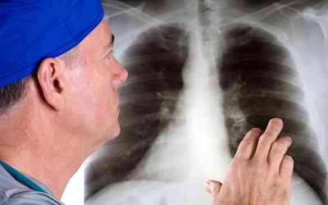
Background
In diagnostic radiology, diseases identified by findings on radiology images (CT/chest X-ray).
Large-scale pneumonia outbreak, high-demand of chest X-ray tests.
Need to accelerate diagnosis.
Notes:
In diagnostic radiology, clinicians often need to identify diseases from radiological images such as CT & chest X-ray, and generate a report for such findings for clinical communication. As computer-aided diagnostics prevails, various research has been done in recent years to automatically generate descriptive texts from radiological images using deep learning models, which can greatly expedite the workflow of radiologists.
During a large-scale pneumonia outbreak such as COVID-19, such automated radiology report generation can become a crucial aid to healthcare workers by accelerating the diagnosis.

Slide 3
Background
Therefore, we want to
Develope a radiology report generator using deep learning.
Automatically generates descriptive text (findings/impressions) of a chest X-ray.
Greatly expedite the workflow of radiologists.
Notes:
Thus, we intend to develop a deep-learning pipeline summarize the preliminary indications in a text report, including findings and impressions based on patients’ imaging results.

Slide 4
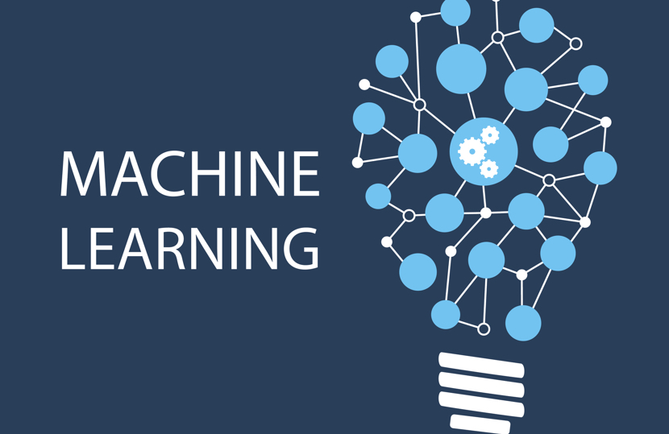
How machine learning/deep learning can help solve this problem
Notes:
为什么认为ML能解决这个问题（能生成report）：有很多dataset并且不同的病的x光片有一定规律？所以可以通过ML学习并且生成report
A critical task in radiology practice is the generation of a free-text report, based on a clinical radiograph (e.g., a chest X-ray).
Providing automated support for this task has the potential to ease clinical workflows and improve both the quality and standardization of care.
However, this process poses significant technical challenges. Many traditional image captioning approaches are designed to produce far shorter and less complex pieces of text than radiology reports.
Further, these approaches do not capitalize on the highly templated nature of radiology reports.
Additionally, generic natural language generation (NLG) methods prioritize descriptive accuracy only as a byproduct of readability, whereas providing an accurate clinical description of the radiograph is the first priority of the report.

Slide 5
Literature survey
Following recent works presented possible approaches toward radiology report generation.
Zhang et al. (2018): summarized radiology report’s findings with extractive and abstractive techniques to generate impression sections.
Han et al. (2018): MRI report generation with limited text training data using weak supervision for a Recurrent-GAN and template-based framework.
Gale et al. (2018): used an RNN to generate template-generated descriptive texts of pelvic X-rays.
Wang et al. (2018): used a CNN-RNN model with attention to generate descriptive texts on chest X-rays based on sequence decoder losses on the generated report.
Li et al. (2018): used reinforcement learning to generate chest X-ray reports.
Notes:
Frequency and Distribution of Chest Radiographic Findings in COVID-19 Positive Patients described radiological findings seen in COVID-19 patients, which is helpful information for related report generation. To summarize, current research on this topic is facing three major challenges: how to localize abnormal regions and produce accurate descriptions, how to generate long texts that contain multiple sentences or even paragraphs, and how to generate multiple heterogeneous forms of information within a unified framework.
We studied related works that explored extractive and abstractive techniques,
Training weak supervision Recurrent-GAN with limited data
generateing template-generated descriptive texts with RNN
generateing descriptive texts using CNN-RNN model with attention
And generateing X-ray reports with reinforcement learning

Slide 6
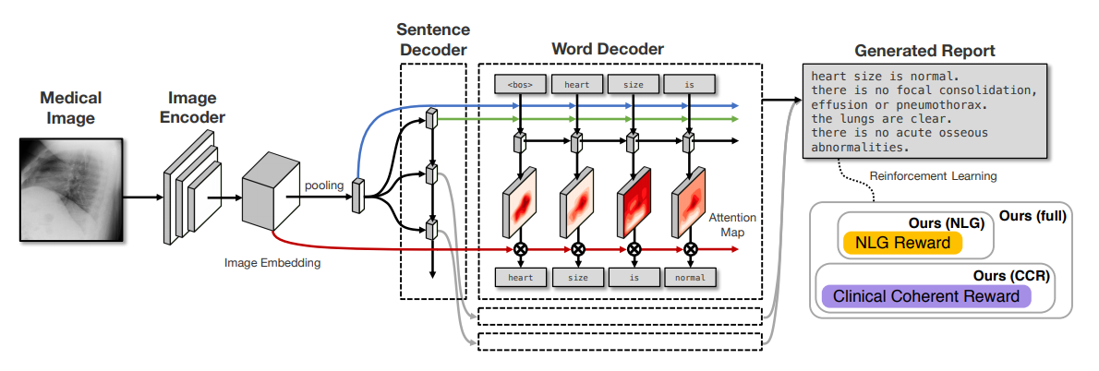
Literature survey
The CNN-RNN-RNN net in paper Clinically Accurate Chest X-Ray Report Generation
Notes:
There is already plenty of research focused on this problem. The basic idea is to implement advanced technology from image feature extraction and natural language generation to produce understandable reports.
Our main reference, Clinically Accurate Chest X-Ray Report Generation, focuses on improving the importance of clinical accuracy in the resulting generated reports. The pipeline adopts the following architecture: a CNN image encoder, a sentence decoder RNN and a word decoder RNN. It first predicts what topics will be discussed in the report, then conditionally generates sentences corresponding to these topics.

Slide 7
Dataset: Chest X-ray Images with Text Reports
Open-I Indiana University Chest X-ray Collection from Indiana Network for Patient Care
Contains 7466 frontal and lateral Chest X-ray images of 3,999 patients
Diagnostic reports including “findings” and “impressions” provided by radiologists
Contains reports for 3852 out of 3999 patients
Some “findings” or “impressions” items are empty
We currently work with “impressions”
Notes:
We re-sized the images to 256*256 for memory efficiency
We are using the

Slide 8
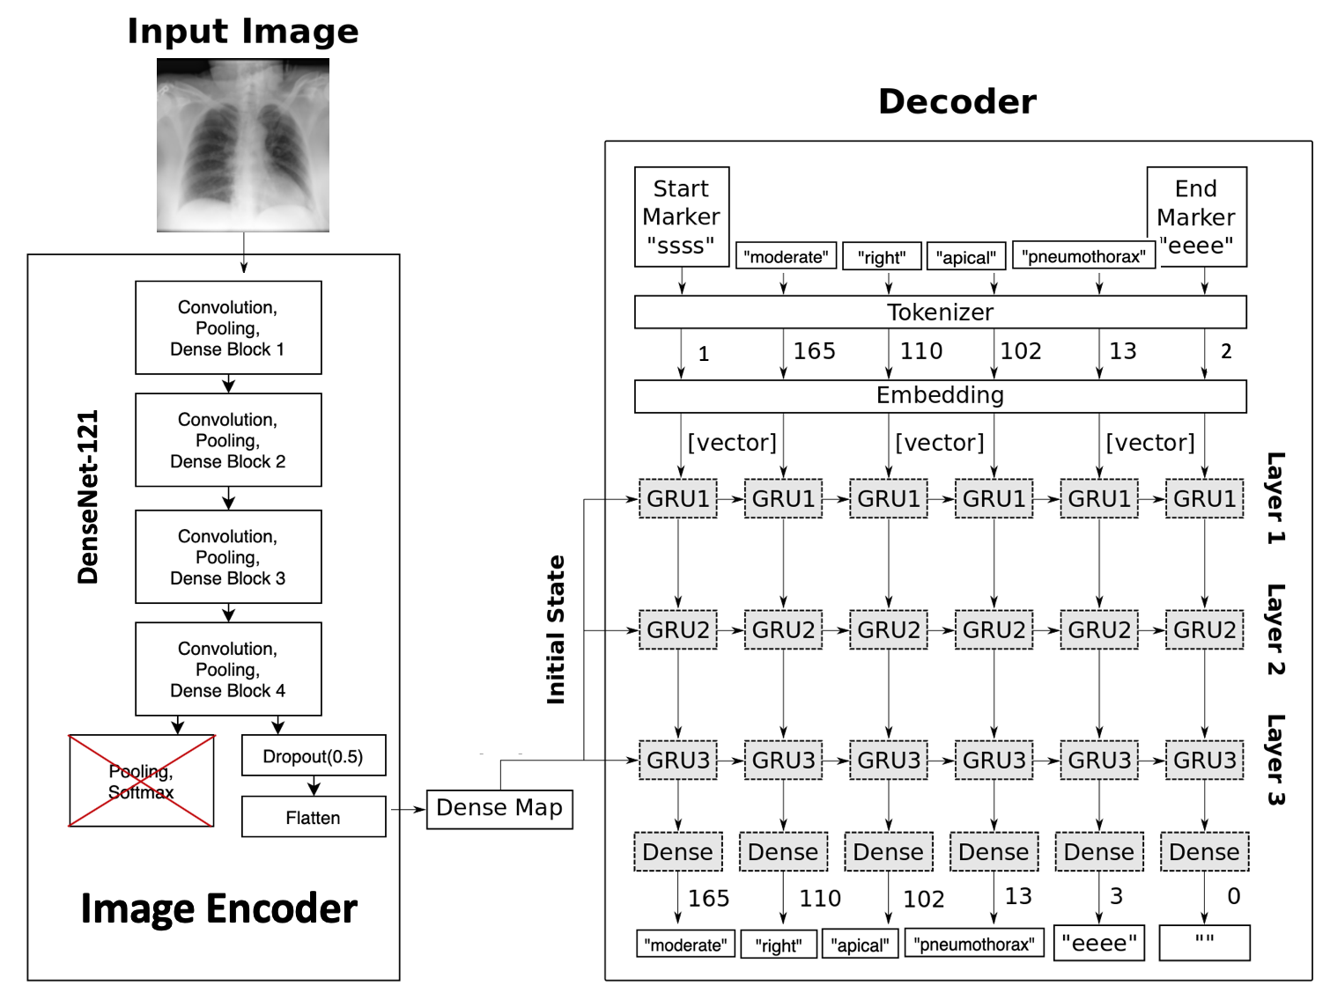
Model Schematic
[512]
Image partially adapted from TensorFlow Tutorial #22
Notes:
Overview: how does this model works
Architecture:
Encoder: feedforward CNN, chest-xray image matrix as input, latent representation as output
Pretrained densenet121
Customized last couple layers
Dropout
Flatten
Densemap - initial state
Decoder RNN
Inputs
Initial state: image embeddings
Word embeddings as a sequence
Outputs: one by one words until hitting max token length
The vertical arrows in the schematic shows that the decoder RNN takes a word embedding and learns to predict the following word in the given sequence to the most likely one, among a dictionary of words. The horizontal arrows shows that the GRUs take the image latent representation as the initial state, then generate a new state to feed into the following GRU.
In the inference mode, only the image latent representations are available to the decoder. It predicts one word at a time until it hits the end marker.

Slide 9
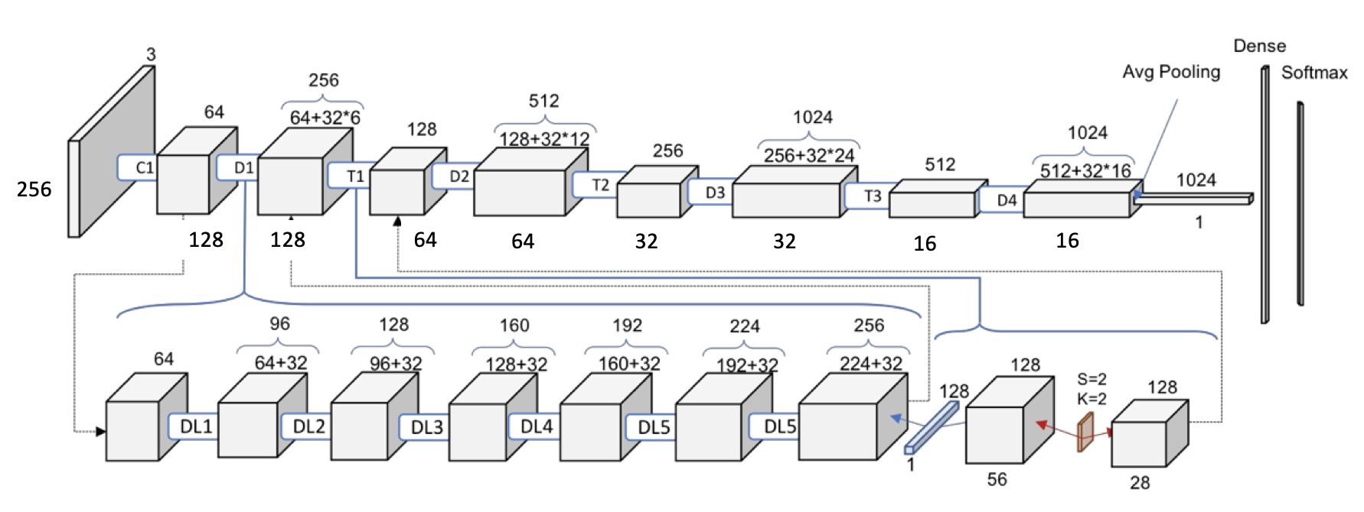
Model Architecture: DenseNet-121
DenseNet-121 Architecture:
Activation: ReLU + tanh
Total parameters: 7,037,504 (DenseNet) + 33,554,944 = 40,592,448
Image partially adapted from Understanding & Visualizing DenseNet-121 by Pablo Ruiz
Notes:
Densenet
Another problem with very deep networks was the problems to train, because of the mentioned flow of information and gradients. DenseNets solve this issue since each layer has direct access to the gradients from the loss function and the original input image.
Traditional feed-forward neural networks connect the output of the layer to the next layer after applying a composite of operations.
DenseBlocks, where the dimensions of the feature maps remains constant within a block, but the number of filters changes between them. These layers between them are called Transition Layers

Slide 10
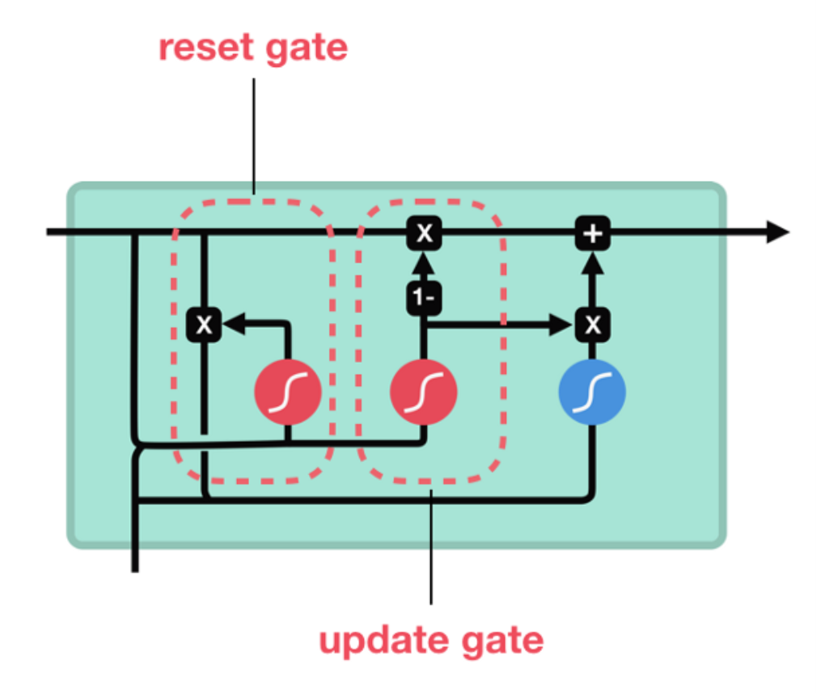
Model Architecture: RNN & GRU Layer
Recurrent Neural Network (RNN)
Widely used for processing sequences
“Information highway” passes hidden state
Gated Recurrent Units (GRU) Architecture:
Newer generation of RNN
More compacted version of LSTM cells
Only update gate & reset gate
Total parameters: 6,060,984
Image partially adapted from Illustrated Guide to LSTM’s and GRU’s: A step by step explanation by Michael Phi

Slide 11
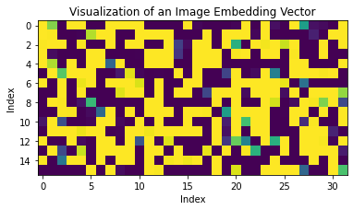
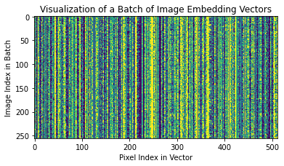
Data Processing & Feature Extraction
Chest X-ray image feature extraction:
Downsized & center-cropped [256x256x3] RGB images
Encoded to an embedding vector of length 512 through CNN encoder model
Notes:
Visualization: output from tanh
Text feature extraction:
Map the token-sequences to themselves shifted one time-step
[1, 3, 285, 102, 136, 58, 20, 28, 38, 59, 106, 117, 13, 24, 21, 46, 82, 51, 14, 54, 3, 4, 5, 10, 59, 2]
No displaced rib fractures, pneumothorax, or pleural effusion identified. Well-expanded and clear lungs. Mediastinal contour within normal limits. No acute cardiopulmonary abnormality identified.
Word frequency
Graph feature extraction:
DenseNet121: a pre-trained dense net model proposed for encode RGB figures.

Slide 12
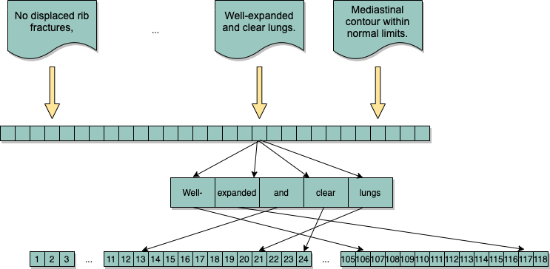
Data Processing & Feature Extraction
Radiology report text image feature extraction:
Mapped string impressions to integer tokens. Word frequency was embedded in the token string.
Notes:
For the text descriptions, we divided them into words and then tokenize them into an integer token string, as shown in the figure. The word frequency was embedded in the string as it was indexed from the most to least frequently appearance.

Slide 13
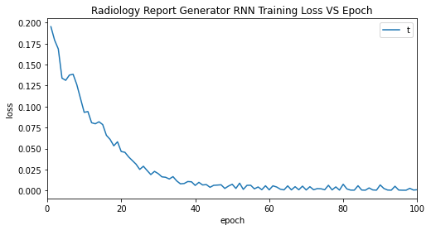
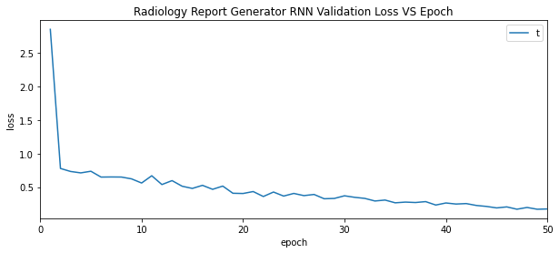
Results: Model Training & Loss Evaluation
Training Parameters
Optimizer: RMSprop
Learning Rate: 1E-4
Loss Function: Sparse categorical cross entropy
Loss at 50 epochs
Training loss: ~0.015
Validation loss: ~0.253

Slide 14
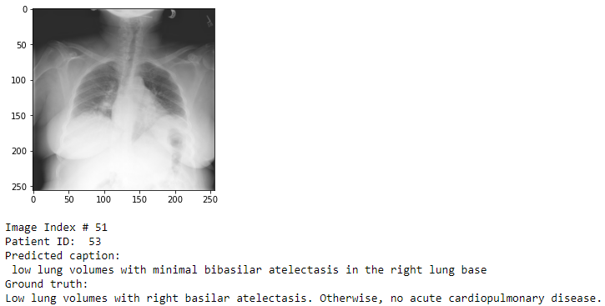
Results & Observations
Compare ground truth and model prediction: training set
The predicted caption of a training image should be rephrasing the ground truth
Possible overfitting If the predicted caption is the same as the ground truth
Notes:
The predicted caption of a training image should have the same meaning as the ground truth but not the same.
If the predicted caption is exactly the same as the ground truth, it
This is the prediction of the frontal image of patient 53, which is in the training set, we can see that the predicted impression is similar to the ground truth. It should has the same meaning as the ground truth but doesn’t need to be the same words. If they are exactly the same, then the model is probably overfitting.

Slide 15
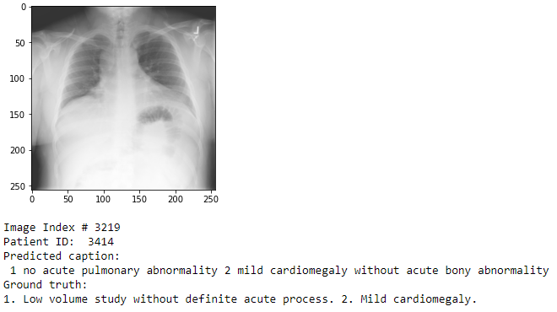
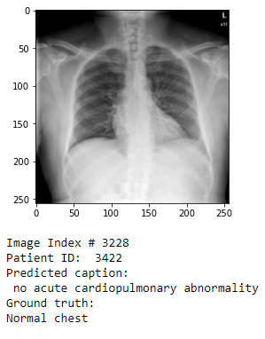
Results & Observations
Compare ground truth and model prediction: validation set
As the above two examples show, the predicted impressions have the same meaning as ground truths but in different words, just as expected.
Notes:
These are the predicted impressions of frontal images of patient 3414 and 3422 in the validation set. For the left one, our model can generate two impressions as the ground truth and pointed out the patient’s cardiomegaly. The right one is normal and its ground truth is normal chest, as our prediction says there is no abnormality, which is the same meaning but in different words.

Slide 16
Further items to be completed before final report submission
Tokenize not only words, but also short phrases.
Use both frontal and lateral images to train the model. (combine view position embedding with the image embedding as the input of the RNN)
Experiment and compare other models(CNN:VGG16, RNN:LSTM, etc.)
Experiment parameters(loss function, activation function, image & text feature size, training epochs, parameters for particular RNN models)
Image pre-process(DCT, corp vs padding, resolution)
There are two major problems:
It can describe the principal part part of the image (such as “there is a heart in the X-Ray image”), but tends to fail describing the details.
It takes too much effort to experiment with larger datasets.
Notes:
Tokenize not only words, but also short phrases.
Use both frontal and lateral images to train the model. (combine view position embedding with the image embedding as the input of the RNN)
Experiment and compare other models(CNN:VGG16, RNN:LSTM, etc.)
Experiment parameters(loss function, activation function, image&text feature size, training epochs, parameters for particular RNN models)
Image pre-process(DCT, corp vs padding, resolution)
There are two major problems:
It is okay to describe the principal part part of the image (such as “there is a heart in the X-Ray image”), but tends to fail describing the details.
It takes too much effort to experiment with larger datasets. (downloading and then upload to datahub, retrain the model with larger dataset

Slide 17
References
Clinically Accurate Chest X-Ray Report Generation
Indiana University Chest X-ray Collection Kohli MD, Rosenman M - (2013)
Frequency and Distribution of Chest Radiographic Findings in COVID-19 Positive Patients
Zhang et al. (2018): summarized radiology report’s findings with extractive and abstractive techniques to generate impression sections.
Han et al. (2018): MRI report generation with limited text training data using weak supervision for a Recurrent-GAN and template-based framework.
Gale et al. (2018): used an RNN to generate template-generated descriptive texts of pelvic X-rays.
Wang et al. (2018): used a CNN-RNN model with attention to generate descriptive texts on chest X-rays based on sequence decoder losses on the generated report.
Li et al. (2018): used reinforcement learning to generate chest X-ray reports.

