Slide 1
GANs for Biological Image Synthesis
(Fluorescent Image )
EE228 Group 49:
Fei Gu: A53391625
Jiaming Lai: A53314574
Yiwei Cheng: A53310006

Slide 2
Background
Literature Review
Dataset
Methods
Current Results
Future Plan
Contents

Slide 3
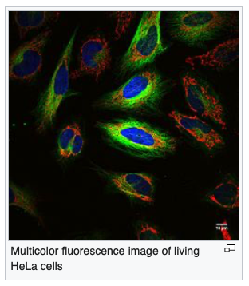
Background
- Fluorescence Imaging
Fission Yeast Cells: Rod shaped unicellular eukaryotes with spherical hemisphere caps that grows in bipolar direction until reach their final length.
Bgs4: The protein tagged in the red channel, is responsible for cell wall remodeling, and localizes to the areas of active growth of cells.
Fluorescence microscopy:
An optical microscope that uses fluorescence compounds to generate images.
Figure 2: Fission Yeast Cell Example[1]
Figure 1: Multicolor fluorescence image of living HeLa cells[10]

Slide 4
Background
-Applying GANs to Fluorescence Microscopy
Generative Adversarial Network (GAN): A famous machine learning framework to generate natural images in the computer vision domain.
The problem to solve: Implement a generative model to synthesize multi-channels fluorescence microscopy images of Fission yeast cells and use several tools to evaluate and improve this model.
Explore novel applications of GANs in fluorescence imaging domain.
Investigate the spatial relationship between different fluorescent proteins during the cell cycle stage.

Slide 5
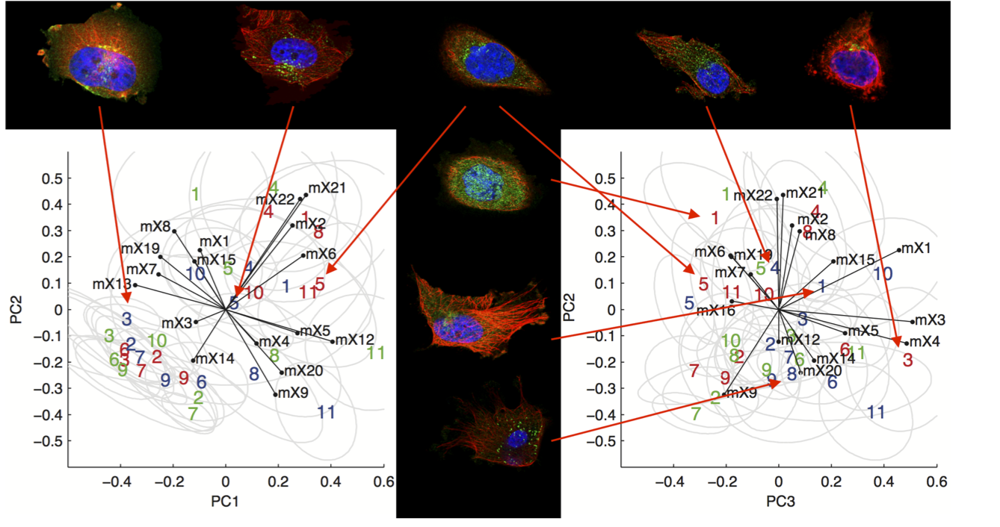
Literature Review
-GANs in Biological Image Analysis
Deep learning approach to do live-cell segmentation.[12]
Use of GANs on samples from fluorescent microscopy automation, and generative models on biology. [8]
Generation of punctuate patterns in cells by Johnson et al [9]
Improvement of large biological datasets algorithm.[13]
Development of scalable platform for biological image data, with open source tools to facilitate the sharing of terabyte sized datasets with complex metadata. [14]
………………..
Figure 4:title to complete
Figure 3:title to complete

Slide 6
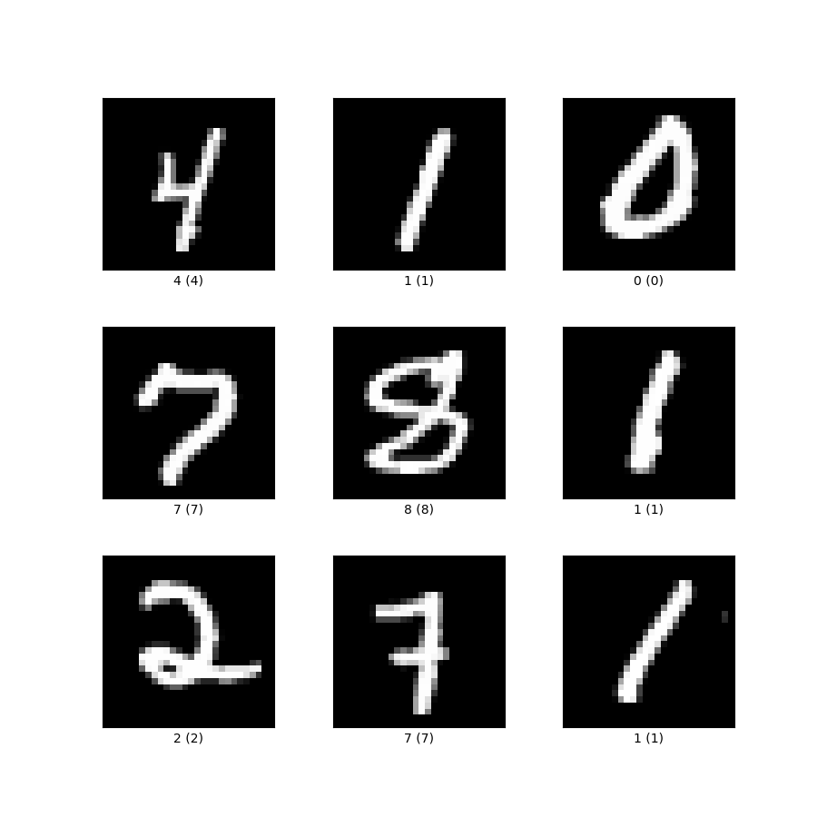
Literature Review
- GANs
GAN: a framework for training a DL model(first train on MNIST) to capture the training data’s distribution so we can generate new data from that same distribution, invented by Goodfellow et. al [2] (2014)
Pix2pix GAN: a general approach for image-to-image translation by P. Isola et. al. [9] based on conditional GAN network. (2017)
Figure 5：MNIST set[12]
image
Stabilizing GAN training
No metric with convergence information
DCGAN: an extension of GAN, explicitly uses convolutional and convolutional transpose layers in the discriminator and generator respectively, first described by Radford et. al [4] (2015)
Wasserstein GAN: a newly proposed GAN algorithm [5] that promises to remedy two problems of GANs. (2017)
[11]

Slide 7
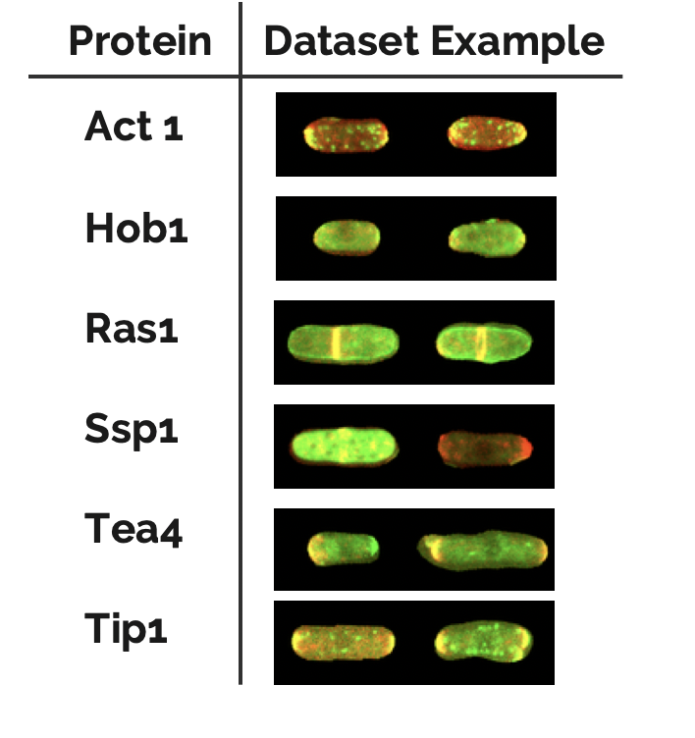
Overview of Dataset
LIN dataset[9]: a dataset (2017) of images of fission yeast cells, which was originally produced to study polarity networks.
Contains totally 170,000 48*80 RGB fluorescence microscopy images in different protein categories.
For each protein category, it has several hundreds of images of different cells.
Every image is composed of two channels, informally called the “red” and the “green”, where light emitted at a precise wavelength is recorded.
Figure 6: Example of LIN dataset
Notes:
4. Details on the dataset. (1 slide)
Did you generate dataset or used it from another source. What are the different classes/dimension and size of data.
In the LIN dataset, the red channel signal always cor- responds to a protein named Bgs4, which localizes to the areas of active growth of cells. The green channel signal in- stead corresponds to any of 41 different “polarity factors”,

Slide 8
Overview of Dataset
Two types of fluorescent-tagged proteins are used: Bgs4 in the red channel, and one of 41 different polarity regulating proteins in the green channel.
Figure 6: Example of LIN dataset
Notes:
4. Details on the dataset. (1 slide)
Did you generate dataset or used it from another source. What are the different classes/dimension and size of data.
In the LIN dataset, the red channel signal always cor- responds to a protein named Bgs4, which localizes to the areas of active growth of cells. The green channel signal in- stead corresponds to any of 41 different “polarity factors”,

Slide 9
GAN vs. WGAN vs. WGN-GP
GAN
Minimax game between two network: generator and discriminator.
Normal GAN cost function is equivalent to minimization of Jensen-Shannon (JS) divergence between two distribution.
WGAN
Proposes a new cost function using Wasserstein distance.
Contribution:
Correlation between loss metric and image quality.
Improve training stability.
Figure 7: Training curves and samples at different stages of training [15]
Notes:
Note:
Normal GAN is actually a minimax game between neural network: generator and discriminator. The generator constructs images given random noise, while the discriminator tries to classify if its input image is real or fake. In GAN, the loss measures how well it fools the discriminator rather than a measure of the image quality. Normal GAN use JS divergence as loss measurement.
WGAN replaces JS divergence with Wasserstein distance to measure loss. The main contribution of WGAN is the following two points: (1) it correlate loss metric and image quality. As we can see in Figure 1, the generator loss in GAN does not drop even the image quality improves. Hence, we cannot tell the progress from its value. We need to save the testing images and evaluate it visually. On the contrary, WGAN loss function reflects the image quality which is more desirable. (2) WGAN improves training stability. Normal GAN is difficult to train. As we can see in Figure 2, without Batch Normalization, standard GAN failed to learn while the WGAN still was able to produce samples.
WGAN-GP add gradient penalty to cost function to improve the image quality.
In general, we implement these three kinds of GAN framework and compare their performance.

Slide 10
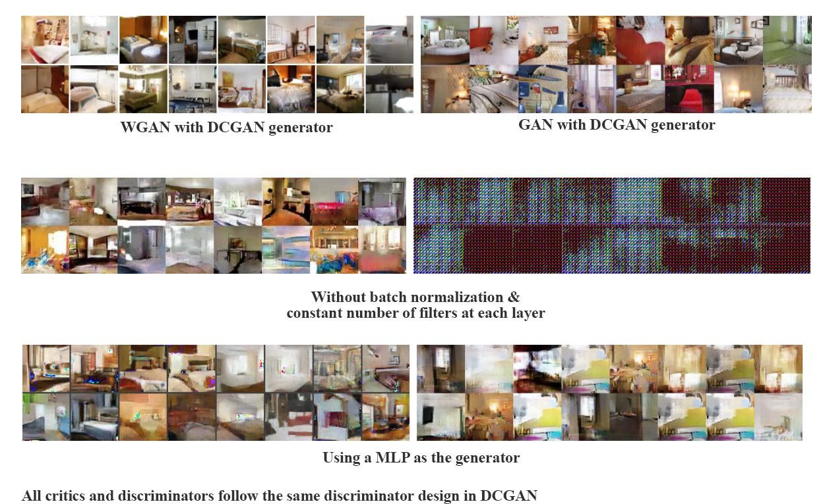
GAN vs. WGAN vs. WGN-GP
GAN
Minimax game between two network: generator and discriminator.
Normal GAN cost function is equivalent to minimization of Jensen-Shannon (JS) divergence between two distribution.
WGAN
Proposes a new cost function using Wasserstein distance.
Contribution:
Correlation between loss metric and image quality.
Improve training stability.
Figure 8: Algorithms trained with a generator without batch normalization [15]
Notes:
Note:
Normal GAN is actually a minimax game between neural network: generator and discriminator. The generator constructs images given random noise, while the discriminator tries to classify if its input image is real or fake. In GAN, the loss measures how well it fools the discriminator rather than a measure of the image quality. Normal GAN use JS divergence as loss measurement.
WGAN replaces JS divergence with Wasserstein distance to measure loss. The main contribution of WGAN is the following two points: (1) it correlate loss metric and image quality. As we can see in Figure 1, the generator loss in GAN does not drop even the image quality improves. Hence, we cannot tell the progress from its value. We need to save the testing images and evaluate it visually. On the contrary, WGAN loss function reflects the image quality which is more desirable. (2) WGAN improves training stability. Normal GAN is difficult to train. As we can see in Figure 2, without Batch Normalization, standard GAN failed to learn while the WGAN still was able to produce samples.
WGAN-GP add gradient penalty to cost function to improve the image quality.
In general, we implement these three kinds of GAN framework and compare their performance.

Slide 11
GAN vs. WGAN vs. WGN-GP
GAN
Minimax game between two network: generator and discriminator.
Normal GAN cost function is equivalent to minimization of Jensen-Shannon (JS) divergence between two distribution.
WGAN
Proposes a new cost function using Wasserstein distance.
Contribution:
Correlation between loss metric and image quality.
Improve training stability.
WGAN-GP
Add gradient penalty to the cost function.
Gradient penalty increases computational, but it does produce higher-quality images.
Notes:
Note:
Normal GAN is actually a minimax game between neural network: generator and discriminator. The generator constructs images given random noise, while the discriminator tries to classify if its input image is real or fake. In GAN, the loss measures how well it fools the discriminator rather than a measure of the image quality. Normal GAN use JS divergence as loss measurement.
WGAN replaces JS divergence with Wasserstein distance to measure loss. The main contribution of WGAN is the following two points: (1) it correlate loss metric and image quality. As we can see in Figure 1, the generator loss in GAN does not drop even the image quality improves. Hence, we cannot tell the progress from its value. We need to save the testing images and evaluate it visually. On the contrary, WGAN loss function reflects the image quality which is more desirable. (2) WGAN improves training stability. Normal GAN is difficult to train. As we can see in Figure 2, without Batch Normalization, standard GAN failed to learn while the WGAN still was able to produce samples.
WGAN-GP add gradient penalty to cost function to improve the image quality.
In general, we implement these three kinds of GAN framework and compare their performance.

Slide 12
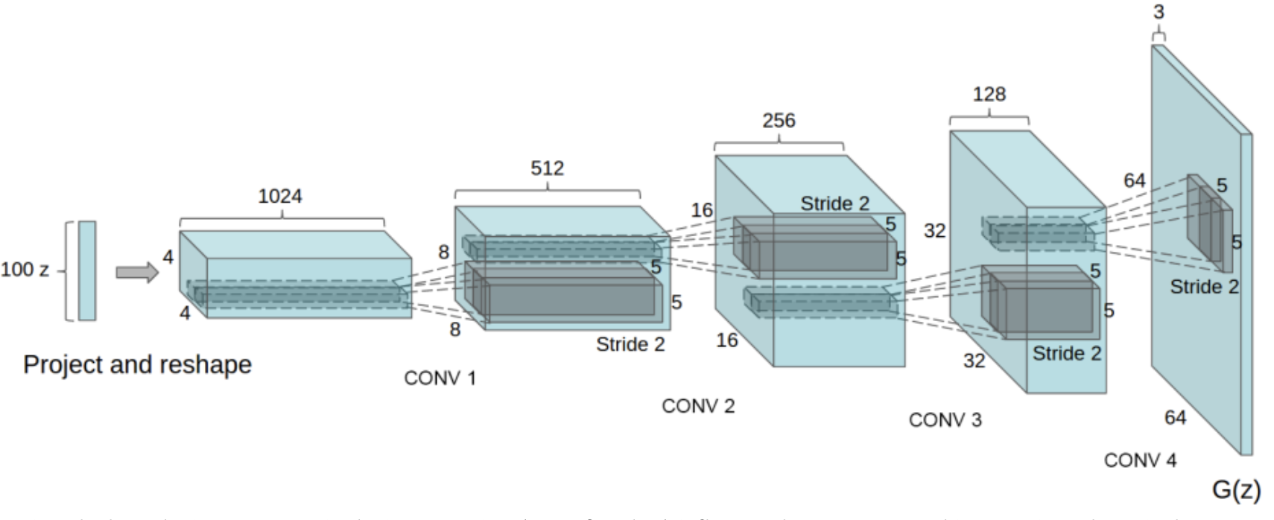
DCGAN
Use CNN in Generator/Discriminator
Generator: 1*1*100 noise -> 48*80*2 image
A series of Upsampling, batchnorm, ReLU/tanh
layers
Discriminator: 48*80*2 image -> final possibility
A series of Convolution, batchnorm, ReLU layers
Sigmoid Output
Figure 9: DCGAN Generator[17]
-Multi-channel DCGAN vs. Multi-channel DCGAN separable
Discriminator: No Difference
Generator: Two channels -> Multi-channel separable DCGAN passes the Upsampling separately and combine together to pass the next layers together.
Notes:
DCGAN: https://pytorch.org/tutorials/beginner/dcgan_faces_tutorial.html

Slide 13
Summary of the approaches
By means of Loss methods
By means of structure
GAN
(Optimizer Adam)
Multi-channel DCGAN
Multi-channel DCGAN
WGAN
(Optimizer: RM-Sprop)
Multi-channel DCGAN separable
WGAN – GP
(Optimizer: Adam)
WGAN – GP
(Optimizer: Adam)
Final preferred model:
WGAN-GP Multi-channel DCGAN
Table 1: Overview of approaches
And we will implement other models to compare the results
Notes:
6

Slide 14
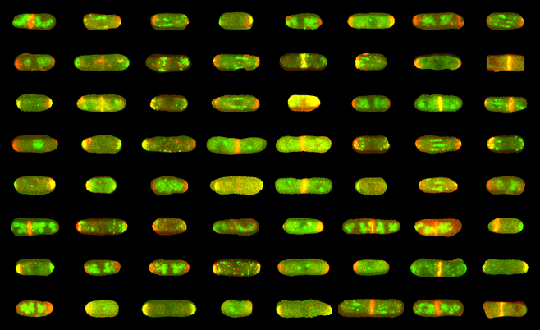
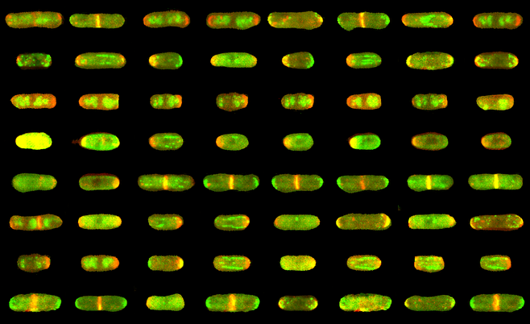
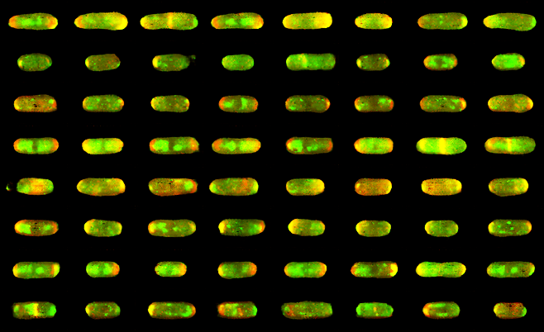
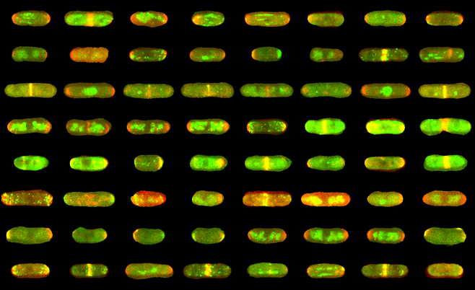
Current Results
Multi-channel DCGAN
Figure 11 shows the generated fake images from DCGAN generator using normal GAN, WGAN and WGAN-GP respectively.
All of these three GAN frameworks could simulate spatial texture in real image.
Figure 10: Real images
Normal GAN, iteration 500000
WGAN, iteration 500000
WGANGP, iteration 100000
Figure 11: Generated Images for normal GAN, WGAN and WGANGPiteration 500000

Slide 15
Current Results
Multi-channel DCGAN
Fail details in some samples.
Figure 10: Real images
Normal GAN, iteration 500000
WGAN, iteration 500000
WGANGP, iteration 100000
Figure 11: Generated Images for normal GAN, WGAN and WGANGPiteration 500000

Slide 16
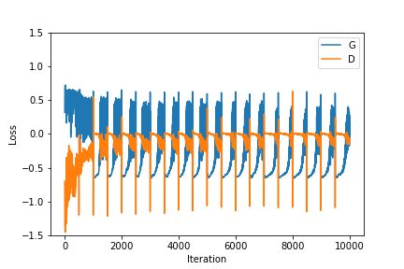
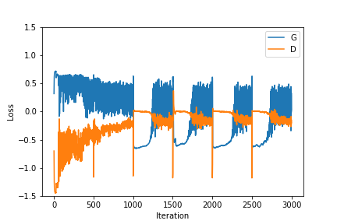
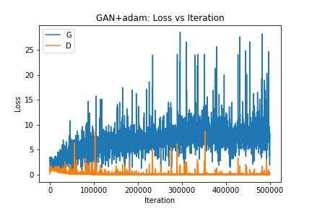
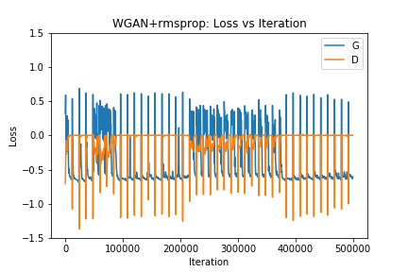
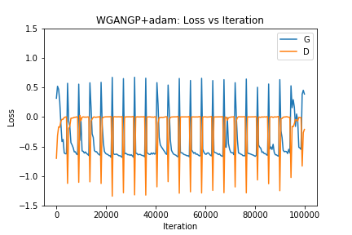
Training Curves
Normal GAN, iteration 500000
WGAN, iteration 500000
WGANGP, iteration 100000
Figure 12: Training curves for Normal GAN, WGAN, WGANGP

Slide 17
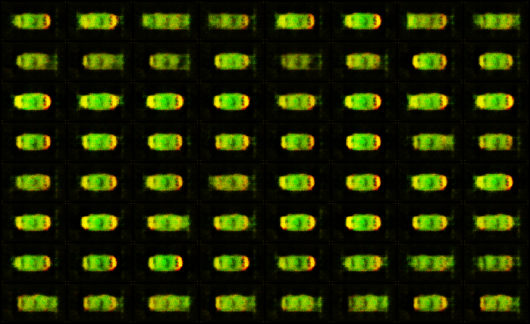
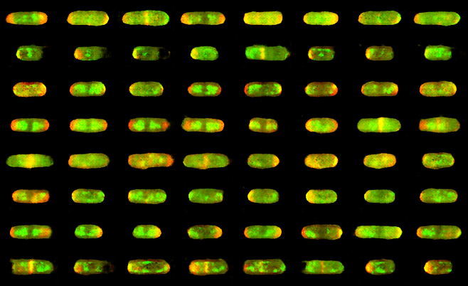
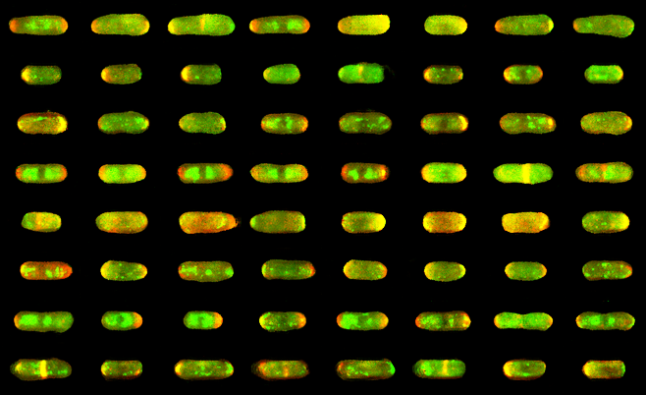
Samples at different stages of WGAN training
Multi-channel DCGAN
Figure 13 shows the generated fake images from DCGAN generator using WGAN at different stages of training progress.
At iteration 500, we could see obvious outline of cell. Generator try to learn spatial detail texture in the following iteration.
Figure 14: Real images
WGAN at iteration 500
WGAN at iteration 20000
WGAN at iteration 300000
Figure 13: Generated Images for WGAN iteration 500, 20000, 30000

Slide 18
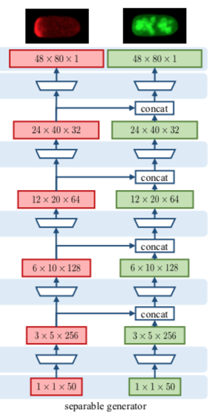
Further items
Use separable generator model and do the same experiment.
Applied the classifier two-sample test (C2ST) to evaluate our GAN models. [16]
Train a fresh discriminator and use the performance of the new discriminator as measure of the quality of the generator.
TBD
Figure 14: Multi-channel DCGAN separable [1]

Slide 19
Thank you for listening! Here lets see the demo of our code…

Slide 20
References
[1] A. Osokin, A. Chessel, R. E. C. Salas, and F. Vaggi. GANs for biological image synthesis. In Proceedings of the International Conference on Computer Vision (ICCV),, 2017
[2] I. Goodfellow. Nips 2016 tutorial: Generative adversarial networks.arXiv preprint arXiv:1701.00160, 2016.
[3] I. Goodfellow, J. Pouget-Abadie, M. Mirza, B. Xu, D. Warde-Farley, S. Ozair, A. Courville, and Y. Bengio. Generative adversarial nets. In Advances in neural information processing systems, pages 2672–2680, 2014
[4] A. Radford, L. Metz, and S. Chintala. Unsupervised representation learning with deep convolutional generative adversarial networks. arXiv preprint arXiv: 1511.06434, 2015
[5] M. Arjovsky, S. Chintala, and L. Bottou. Wasserstein gan.arXiv preprint arXiv:1701.07875, 2017.
[6] Gulrajani, F. Ahmed, M. Arjovsky, V. Dumoulin, and A. C. Courville. Improved training of wasserstein gans. In Advances in neural information processing systems, pages 5767–5777, 2017
[7] P. Isola, J.-Y. Zhu, T. Zhou, and A. A. Efros. Image-to-image translation with conditional adversarial networks. In Proceedings of the IEEE conference on computer vision and pattern recognition, pages 1125–1134, 2017
[8] R. F. Murphy. Building cell models and simulations from microscope images. Methods, 96:33–39, 2016.
[9] J. Dodgson, A. Chessel, F. Vaggi, M. Giordan, M. Yamamoto, K. Arai, M. Madrid, M. Geymonat, J. F. Abenza, J. Cansado, M. Sato, A. Csikasz-Nagy, and R. E. Carazo Salas. Reconstructing regulatory pathways by systematically mapping protein localization interdependency networks. bioRxiv:11674, 2017.
[10] https://commons.wikimedia.org/wiki
[11]http://yann.lecun.com/exdb/mnist/

Slide 21
References
[12]D.A.VanValen,T.Kudo,K.M.Lane,D.N.Macklin,N.T. Quach, M. M. DeFelice, I. Maayan, Y. Tanouchi, E. A. Ash- ley, and M. W. Covert. Deep Learning Automates the Quan- titative Analysis of Individual Cells in Live-Cell Imaging Ex- periments. PLOS Computational Biology, 12(11):e1005177, 2016.
[13]V. Ljosa, K. L. Sokolnicki, and A. E. Carpenter. Annotated high-throughput microscopy image sets for validation. Na- ture Methods, 9(7):637, 2012.
[14]E. Williams, J. Moore, S. W. Li, G. Rustici, A. Tarkowska, A. Chessel, S. Leo, B. Antal, R. K. Ferguson, U. Sarkans, A. Brazma, R. E. Carazo Salas, and J. Swedlow. The Im- age Data Resource: A scalable platform for biological image data access, integration, and dissemination. Nature Methods, 14:775–781, 2017.
[15] Arjovsky, M., Chintala, S. and Bottou, L., 2017. Wasserstein gan. arXiv preprint arXiv:1701.07875.
[16] D. Lopez-Paz and M. Oquab. Revisiting classifier two- sample tests. In ICLR, arXiv:1610.06545v3, 2017. 2, 5

