Slide 1
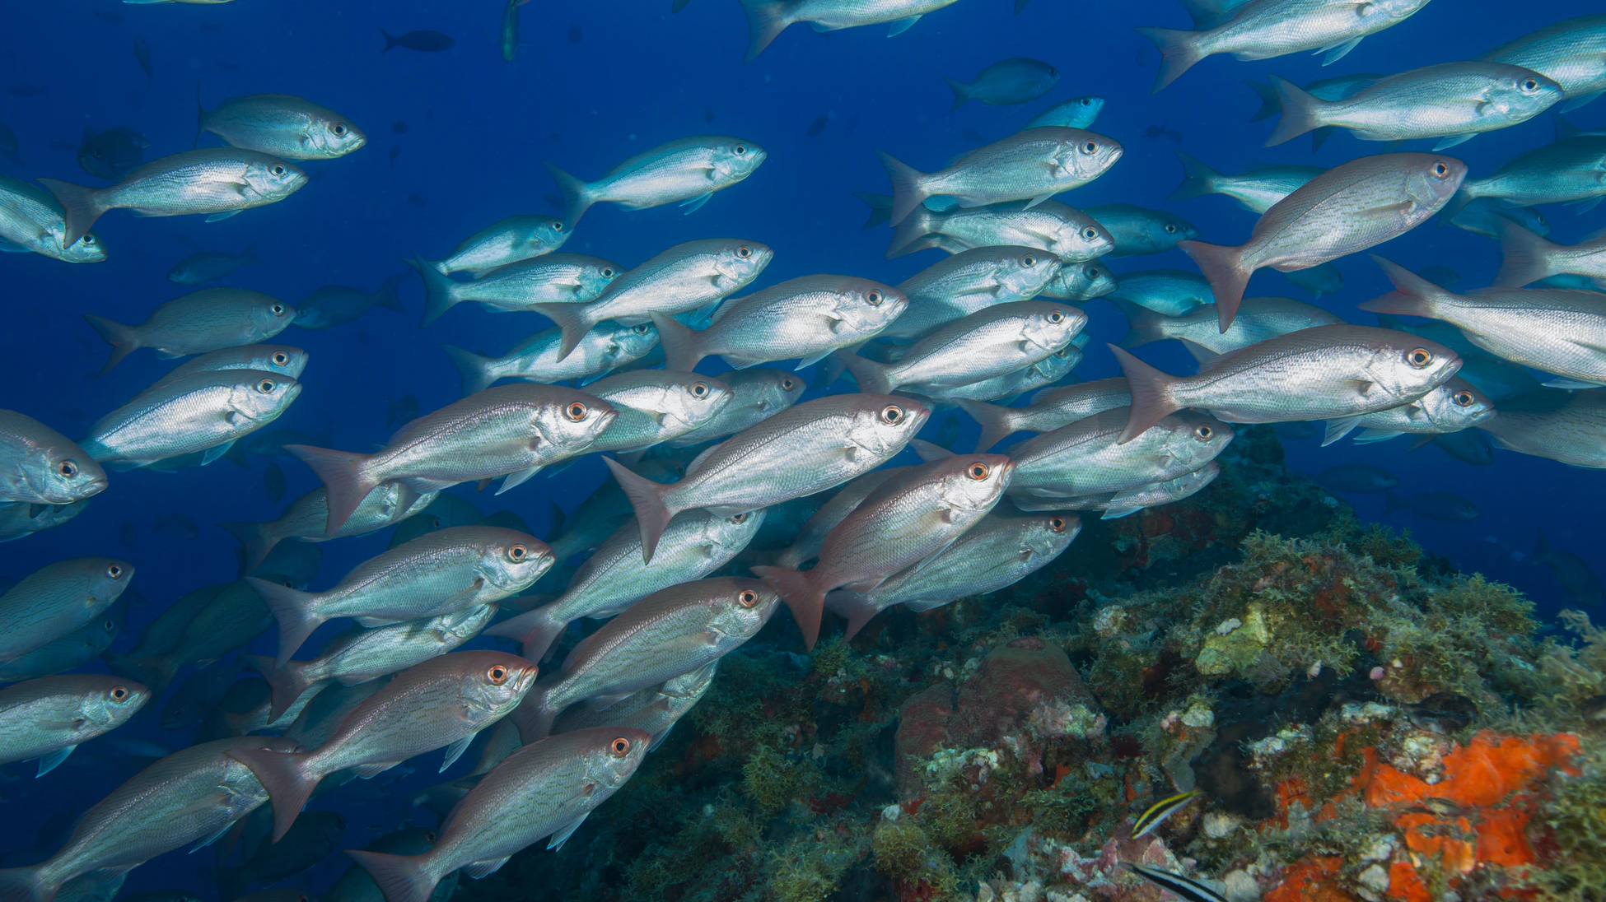
Identifying Fish Species With A Convolutional Neural Network
Abdullah Albattal and Anjali Narayanan
Group 11
ECE 228 – Machine Learning for Physical Applications

Slide 2
Monitoring and management of fish population:
Track changes due to persistent environmental/climate stressors
Understanding current issues with problematic fisheries (e.g. overexploitation, illegal, unreported, and unregulated fishing)
Efficient data management
The need for species identification
The solution must be:
Reliable
Standardized
Cost-effective

Slide 3
Organizations can employ:
Electronic reporting
Citizen science programs/working with fishermen
How can we implement solutions?
The implementation of these tools along with artificial intelligence can provide more real-time robust data collection to inform adaptive fisheries management and achieve climate-ready fisheries

Slide 4
Why deep learning?
Non-intrusive, effective, and portable classification method
Accessible by experts and non-experts
Can be applied to species identification and population management.

Slide 5
Current efforts
Most algorithms classify based on shape, color, contour and/or texture feature extraction and matching and date back to 1989 ^{1,2}
A wide range of approaches have been used including:
Artificial neural networks and conventional backpropagation ³
Multi-class support vector machine ⁴
Convolutional neural networks ⁵
Combination CNNs with other hierarchy-based feature engineering ⁶

Slide 6
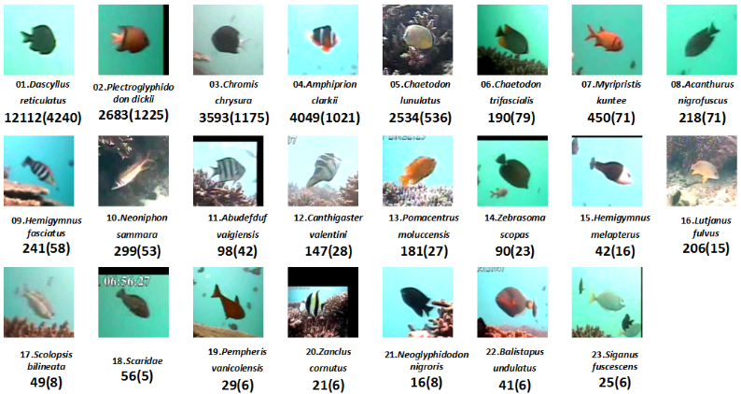
Our approach
Follow the method of Rathi et al. (2018): Underwater Fish Species Classification using Convolutional Neural Network and Deep Learning
Data used in the paper is available online ⁷
RGB images include fish in natural habitat
Binary masks are included to isolate fish from background
Conduct pre-processing on imagery
Recreate Rathi et al. CNN and try to improve on it
Figure 1. A sample of the dataset as used in Rathi et al. (2018)
http://groups.inf.ed.ac.uk/f4k/GROUNDTRUTH/RECOG/

Slide 7
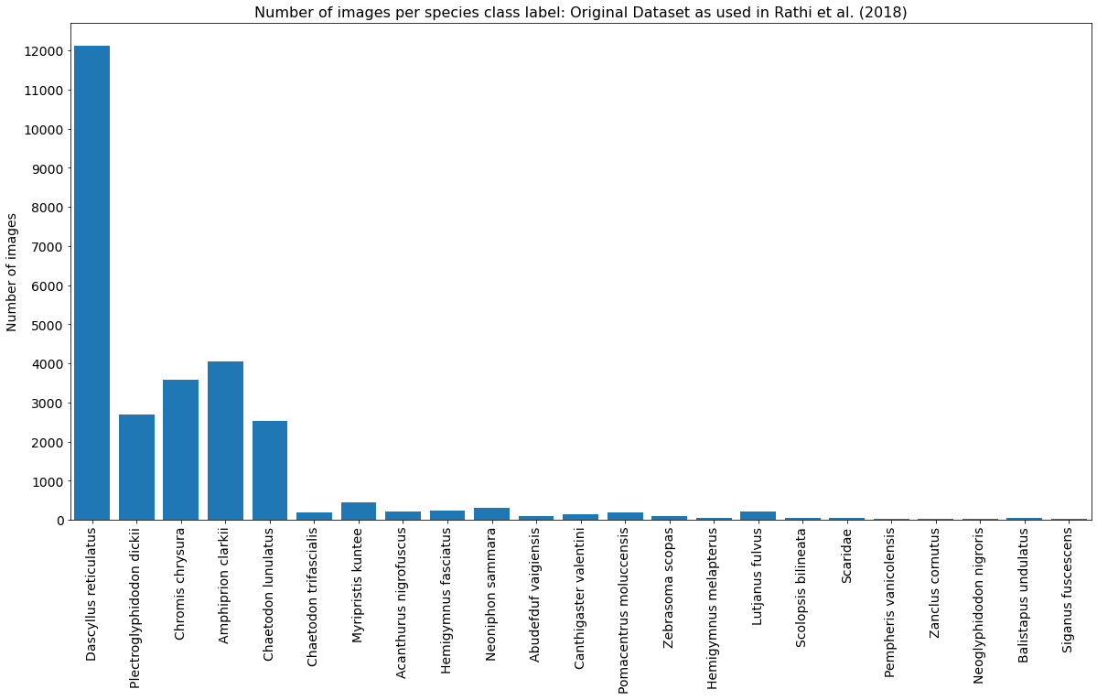
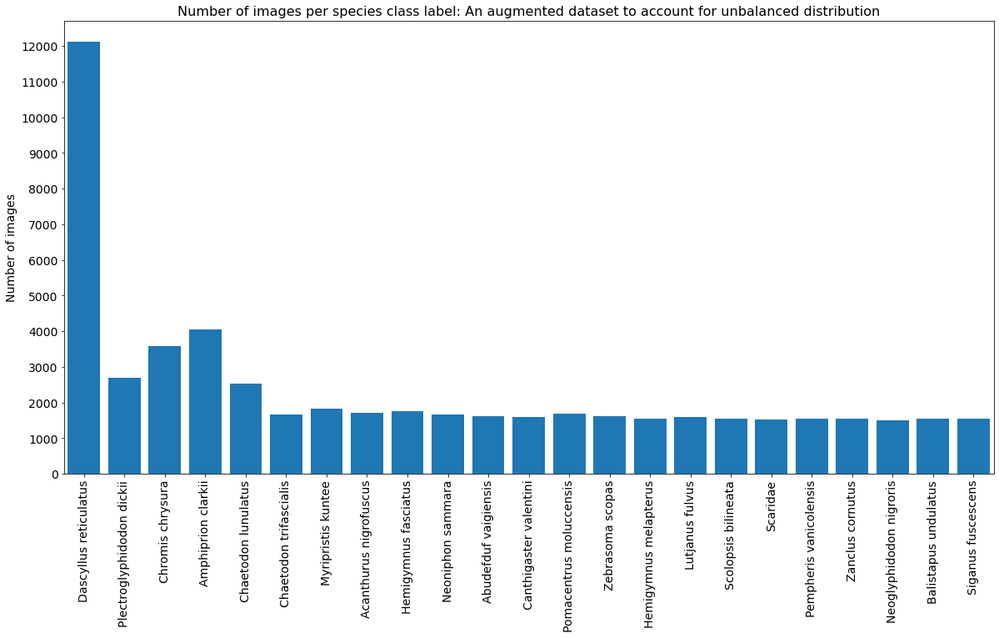
Distribution of Data and Augmentation
Original Dataset
Augmented Dataset
Figure 2. The distribution of the data as in the dataset used in Rathi et al (2018) (left) and after the data was augmented (right) .

Slide 8
Pre-processing
Steps as described in Rathi et al. (2018):
Scaling the images intensities to [0, 1] & size to (100*100*3)
Appending the masks
Size of 100*100*3 → 100*100*4 (input to CNN)
Our implementation (Improvements):
Augmentation:
X-axis flipping, translation, brightness, and rotation.
Concatenation and storing dataset into a binary file (npy file)
Augmentation
Original
Flipping
Brightness
Translation
Figure 3. Augmentation Examples

Slide 9
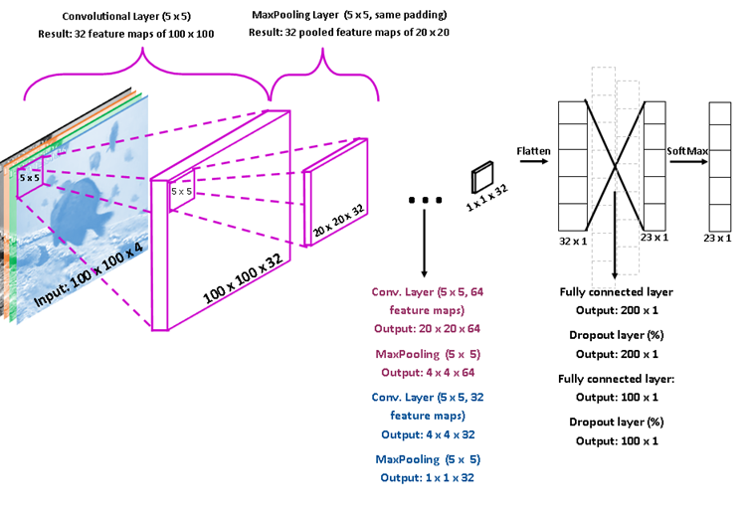
The Convolutional Neural Network
3 Conv2D Layers
3 MaxPool Layers
3 Dense Layers
2 Dropout (between dense)
Activation functions: ReLu, tanh, sigmoid
Compiled with:
Categorical cross entropy loss
Adam optimizer
Figure 4. A visual of the CNN

Slide 10
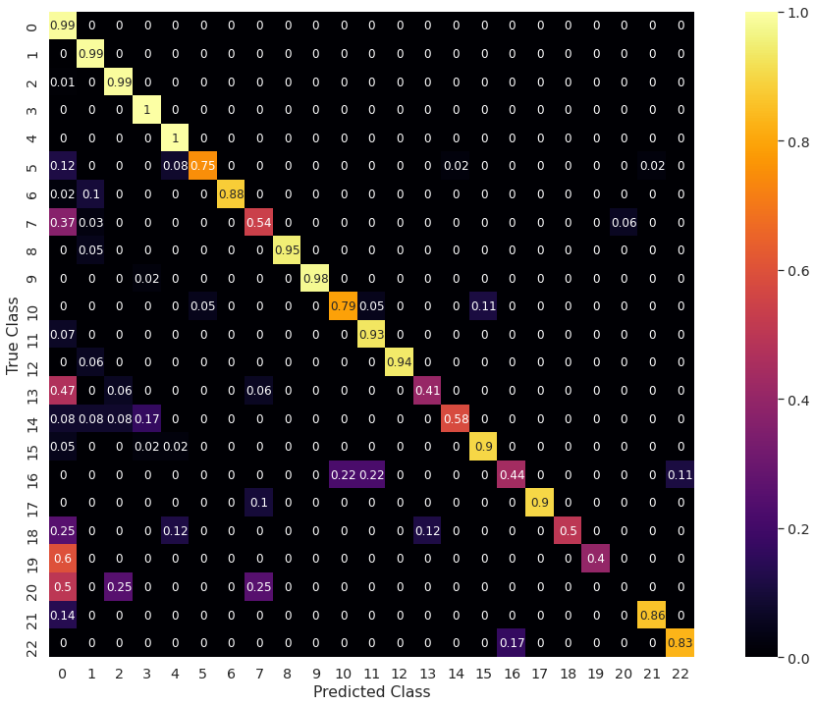
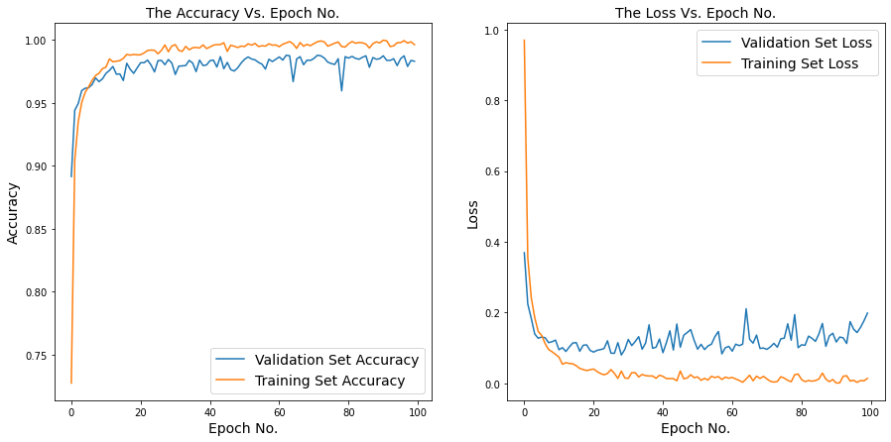
Results from the Rathi Architecture (ReLu)
Original Dataset
Conv2D (32 feature maps) → Maxpool
Conv2D (64 feature maps) → Maxpool
Conv2D (32 feature maps) → Maxpool
Flatten
Dense (200 perceptrons) → Dropout (20%)
Dense (100 perceptrons) → Dropout (20%)
Dense (23 perceptrons)
Resulting test accuracy = 97.2%
Overfitting
Figure 5. Accuracy (left), loss (middle) for training and validation and confusion matrix (right) for test dataset

Slide 11
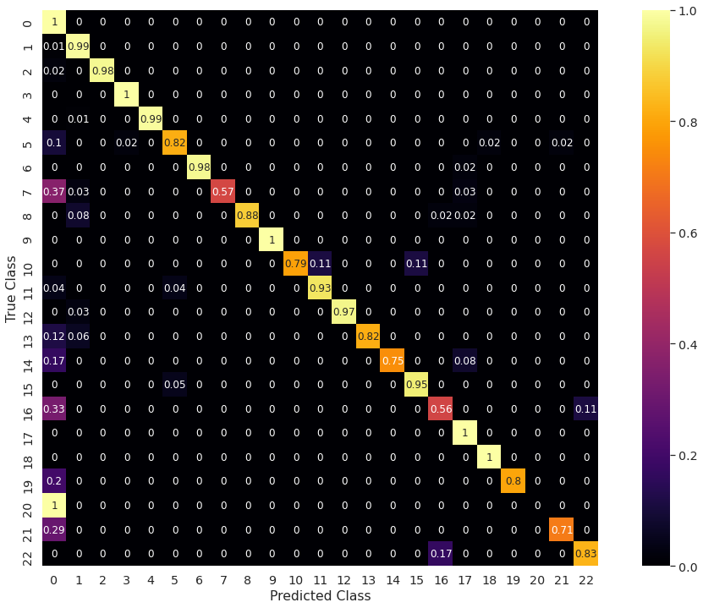
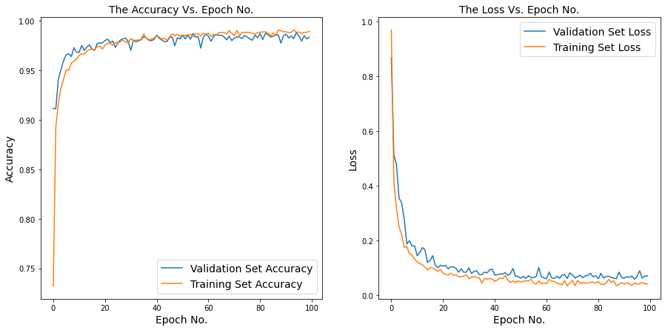
Results from our Proposed Improved CNN Model
Original Dataset
Conv2D (64 feature maps) → Dropout (40%) → Maxpool
Conv2D (32 feature maps) → Dropout (40%) → Maxpool
Flatten
Dense (200 perceptrons) → Dropout (40%)
Dense (100 perceptrons) → Dropout (40%)
Dense (23 perceptrons)
Resulting test accuracy = 98.3%
No Overfitting
Figure 6. Accuracy (left), loss (middle) for training and validation and confusion matrix (right) for test dataset

Slide 12
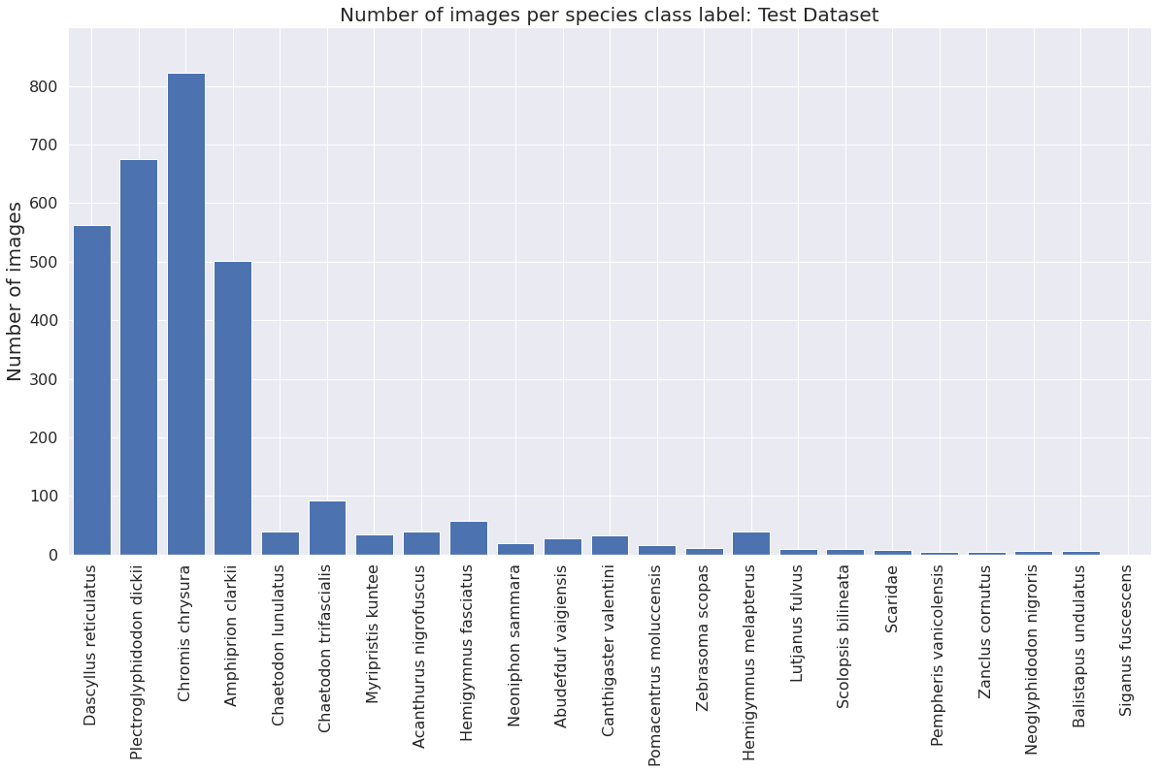
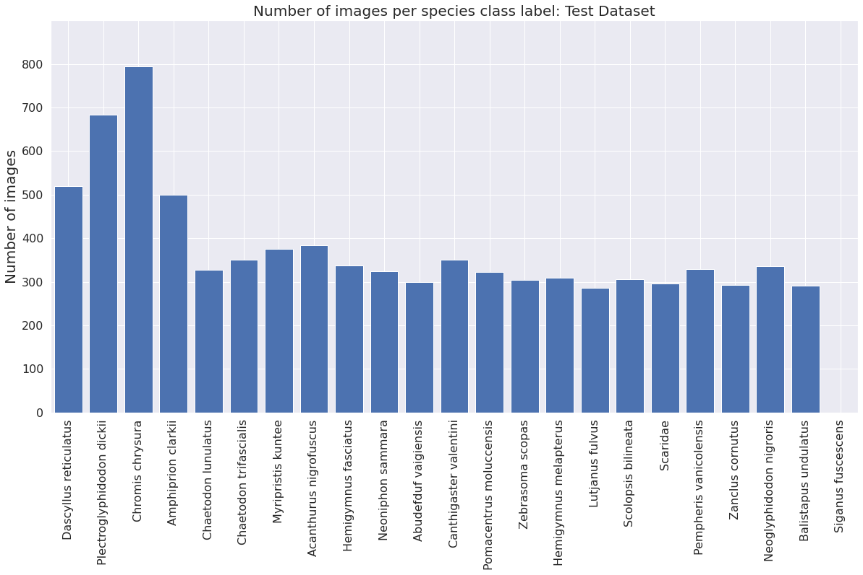
Distribution of Test Data
Figure 7. The distribution of the data as in the test dataset used in Rathi et al (2018) (left) and after the data was augmented (right) .
Before augmentation: Not very good distribution of images across classes
Solution: Run the models on the “new” dataset (original + augmented data)

Slide 13
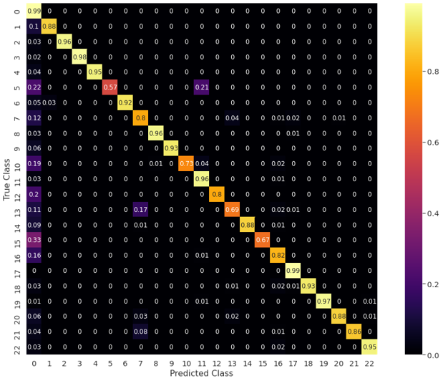
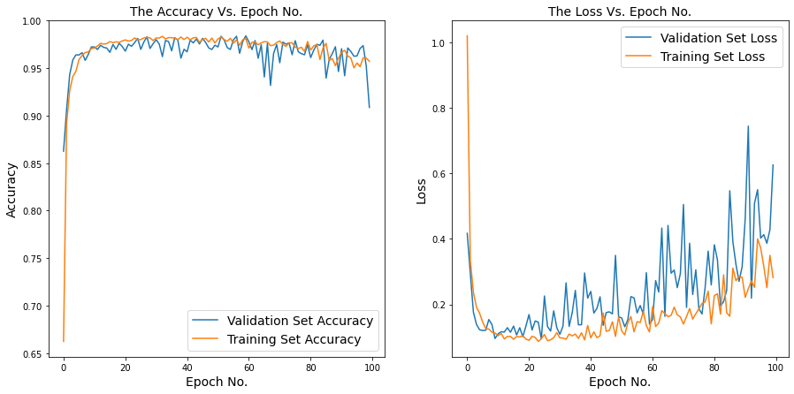
Results from the Rathi Architecture (ReLu)
Augmented Dataset
Conv2D (32 feature maps) → Maxpool
Conv2D (64 feature maps) → Maxpool
Conv2D (32 feature maps) → Maxpool
Flatten
Dense (200 perceptrons) → Dropout (20%)
Dense (100 perceptrons) → Dropout (20%)
Dense (23 perceptrons)
Resulting test accuracy = 90.6%
Overfitting
Figure 8. Accuracy (left), loss (middle) for training and validation and confusion matrix (right) for test dataset

Slide 14
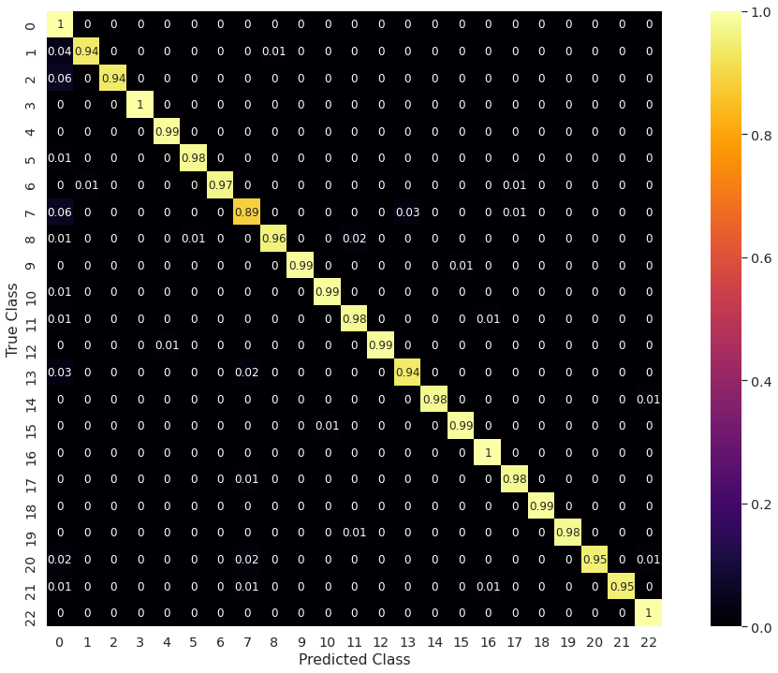
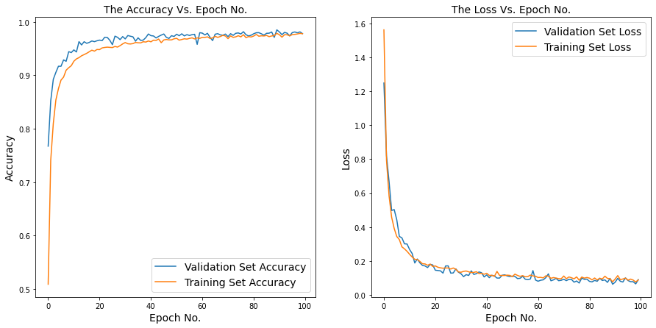
Results from our Proposed Improved CNN Model
Augmented Dataset
Conv2D (64 feature maps) → Dropout (40%) → Maxpool
Conv2D (32 feature maps) → Dropout (40%) → Maxpool
Flatten
Dense (200 perceptrons) → Dropout (40%)
Dense (100 perceptrons) → Dropout (40%)
Dense (23 perceptrons)
Resulting test accuracy = 98.4%
No Overfitting
Figure 9. Accuracy (left), loss (middle) for training and validation and confusion matrix (right) for test dataset

Slide 15
Next steps
Apply the CNN to a dataset obtained from a local fisheries organization (The Nature Conservancy) - Not public
Develop a masking algorithm for these images (different from the masks provided by online dataset)
Determine if length of fish can be determined via another learning protocol to help identify fish morphology

Slide 16
References
[1] S. A. Siddiqui et al., “Automatic fish species classification in underwater videos: Exploiting pre-trained deep neural network models to compensate for limited labelled data,” ICES J. Mar. Sci., 2017.
[2] D. Rathi, S. Jain, and S. Indu, “Underwater Fish Species Classification using Convolutional Neural Network and Deep Learning,” in 2017 9th International Conference on Advances in Pattern Recognition, ICAPR 2017, 2018.
[3] F. Storbeck and B. Daan, “Fish species recognition using computer vision and a neural network,” Fish. Res., 2001.
[4] J. Hu, D. Li, Q. Duan, Y. Han, G. Chen, and X. Si, “Fish species classification by color, texture and multi-class support vector machine using computer vision,” Comput. Electron. Agric., 2012.
[5] S. Villon, M. Chaumont, G. Subsol, S. Villéger, T. Claverie, and D. Mouillot, “Coral reef fish detection and recognition in underwater videos by supervised machine learning: Comparison between deep learning and HOG+SVM methods,” in Lecture Notes in Computer Science (including subseries Lecture Notes in Artificial Intelligence and Lecture Notes in Bioinformatics), 2016, vol. 10016 LNCS, pp. 160–171.
[6] A. Salman et al., “Fish species classification in unconstrained underwater environments based on deep learning,” Limnol. Oceanogr. Methods, 2016.
[7] “Protect Ocean Health in the Digital Age.” The Nature Conservancy, 2 Jan. 2020, www.nature.org/en-us/what-we-do/our-priorities/provide-food-and-water-sustainably/food-and-water-stories/fisheries-big-data/.

Slide 17
Thank you!
Abdullah Albattal and Anjali Narayanan

