Slide 1
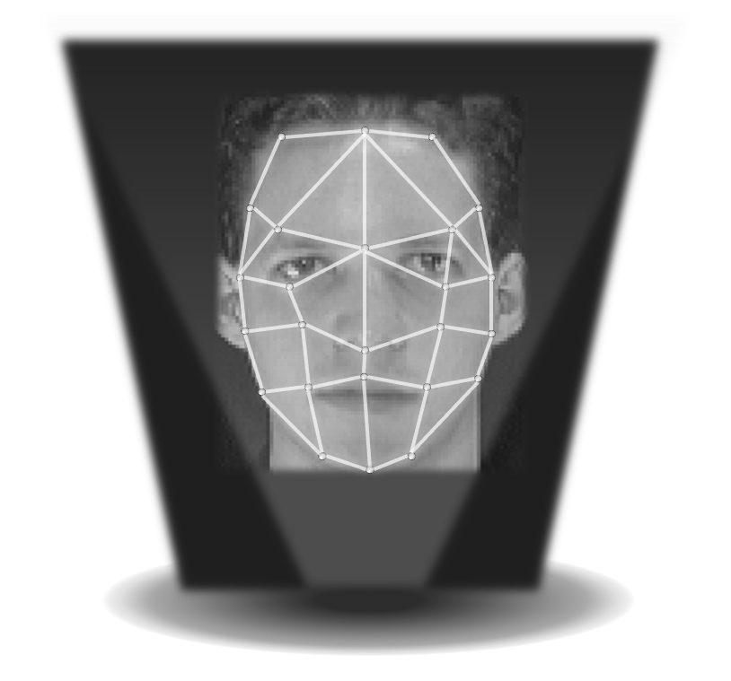
Facial recognition using deep learning neural networks techniques
Ivan Ferrier
Yunzhang Liu
Rom Tendencia
Department of ECE Engineering
University of California, San Diego
03 June 2021

Slide 2
BackGround
Facial detection is an object detection classifier.
Applications for face recognition:
Homeland security.
Law enforcement agencies.
Smart-phones.
Notes:
Introduction/ Background - Facial detection/ recognition/ ID (Literature work/ history)

Slide 3
ORL Dataset https://www.kaggle.com/kasikrit/att-database-of-faces

Slide 4
Different images of the same person

Slide 5
The focus on neural network facial recognition...
Feature Extraction:
Principal component analysis (PCA)
Independent component analysis (ICA)
Linear discrimination analysis (LDA)
Neural Network:
Convoluted neural network

Slide 6
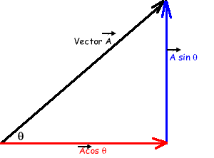
Principal Component Analysis [PCA]
Breaking things into analizable components is something we are all familiar with

Slide 7
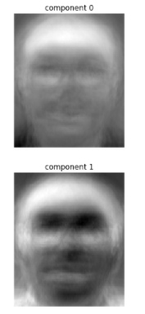
Principal Component Analysis [PCA]
Breaking things into analizable components is something we are all familiar with

Slide 8
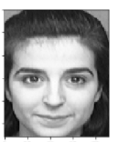
Principal Component Analysis [PCA]
Breaking things into analizable components is something we are all familiar with

Slide 9
Principal Component Analysis [PCA]
Breaking things into analizable components is something we are all familiar with

Slide 10
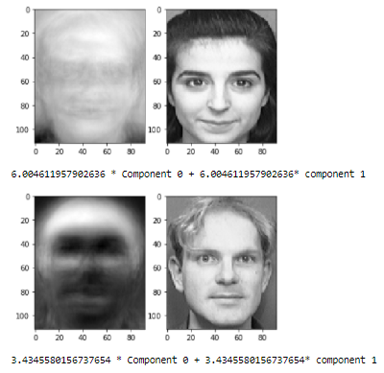
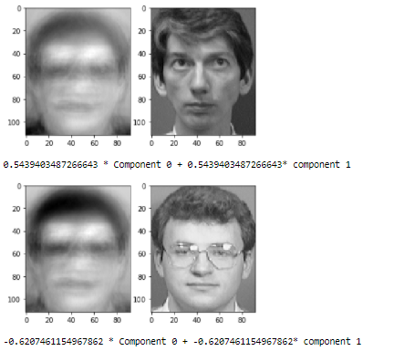
Principal Component Analysis [PCA]
Four subjects recreated based on 2 component decomposition

Slide 11
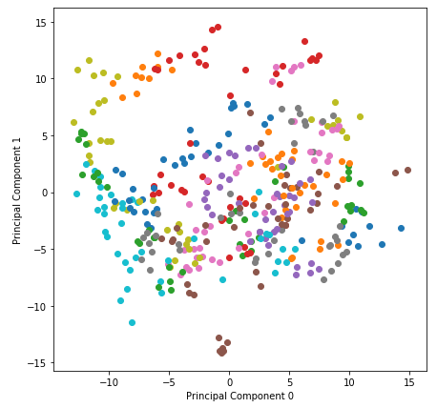
Principal Component Analysis [PCA]
Four subjects recreated based on 2 component decomposition
Unclear
Clear

Slide 12
Principal Component Analysis [PCA]
The number of components used dictates how well we can represent the subject

Slide 13
Principal Component Analysis [PCA]
The number of components used dictates how well we can represent the subject

Slide 14
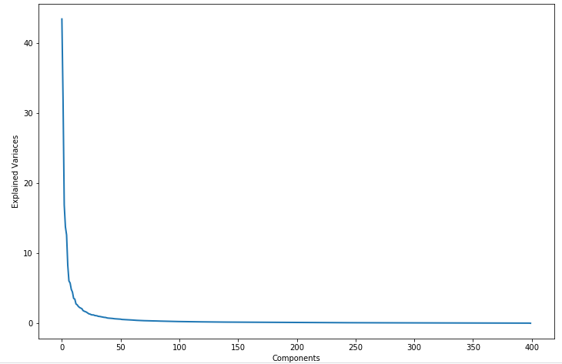
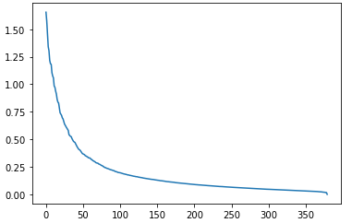
Principal Component Analysis [PCA]
The number of components used dictates how well we can represent the subject

Slide 15
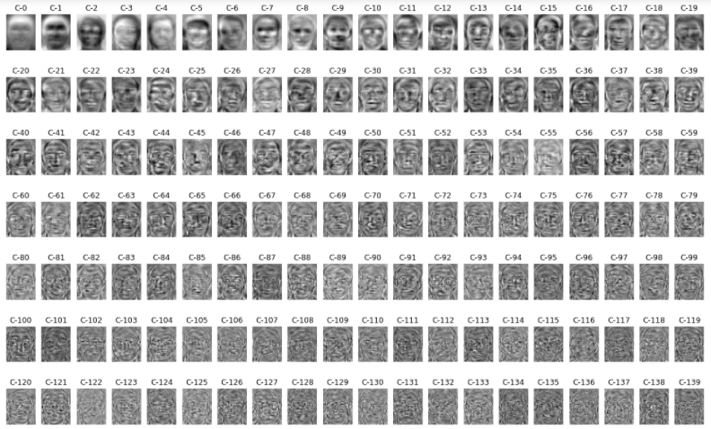
Principal Component Analysis [PCA]
The number of components used dictates how well we can represent the subject

Slide 16
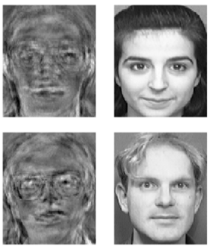
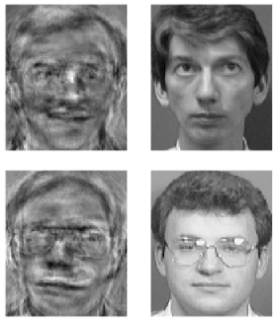
Principal Component Analysis [PCA]
The number of components used dictates how well we can represent the subject

Slide 17
Principal Component Analysis [PCA]
The number of components used dictates how well we can represent the subject
Unclear
Clear

Slide 18
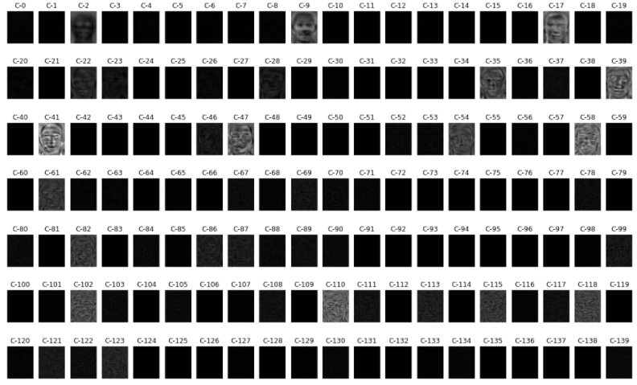
Principal Component Analysis [PCA]
The number of components used dictates how well we can represent the subject

Slide 19
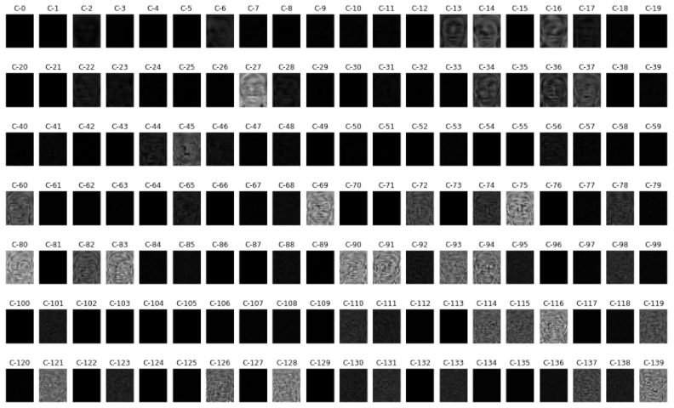
Principal Component Analysis [PCA]
The number of components used dictates how well we can represent the subject

Slide 20
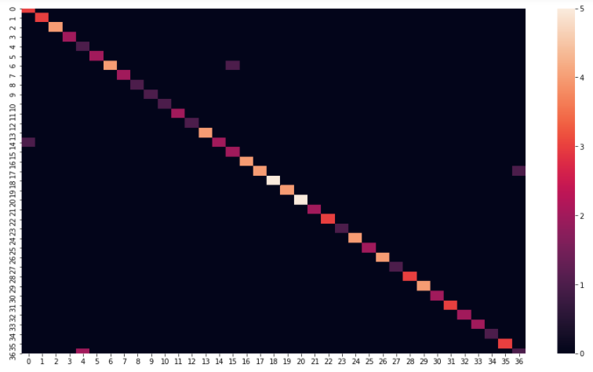
Principal Component Analysis [PCA]
Using 140 components, we can achieve a high accuracy
accuracy score:95.00%

Slide 21
Independent Component Analysis (ICA)
Test Set
Measured Signal
ICA
Independent Sources
...
(M₁ x N_{j})
Focus: Independence
Technique: Transforms a set of vectors into individual components from maximum mutual information transfer.
(M_{i}xN_{j} )

Slide 22
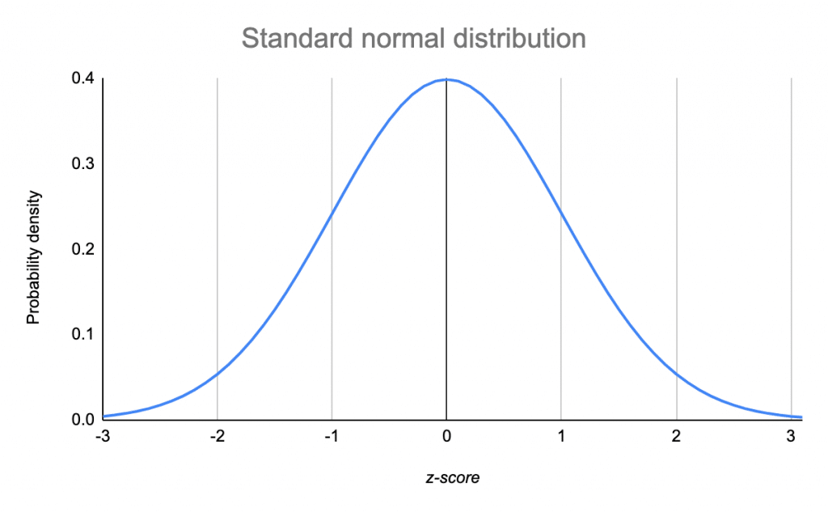
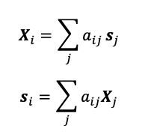
Independent Component Analysis (ICA)
Principles
Assumptions:
Source signals are statistically independent.
Each source signal have non-gaussian distribution values.
Effects of mixed signals:
Independence
Normality
Complexity
or

Slide 23
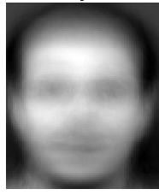
Independent Component Analysis (ICA)
Test Set
Measured Signal
ICA
Independent Components
...
...
M₄₀ x N₁₀
M₁ x N₁₄₀

Slide 24
Independent Component Analysis (ICA)

Slide 25
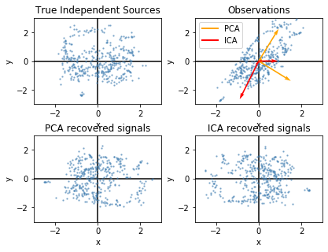
Independent Component Analysis (ICA)
Accuracy: 97.00%

Slide 26
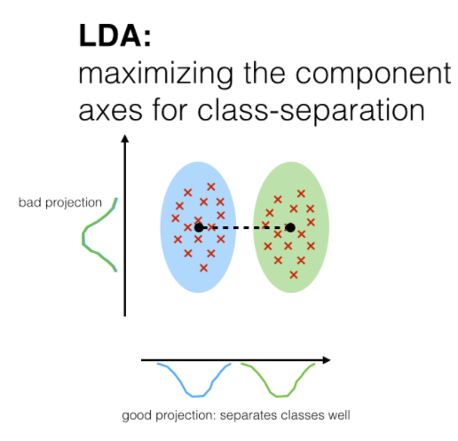
Linear Discrimination Analysis (LDA)
Main Idea: Project dataset(dim d) onto lower dimensional(k<d) space
Supervised
Class label
maximizes the separation between different classes
Mean of classes
Scatter matrices
Highest eigenvalues
Underperforming on small samples

Slide 27
LDA Result
With Support Vector Machine
With Linear Regression

Slide 28
Convoluted Neural Network
The shape of original image is (92,112) which is pretty hard for computation, so we reshaped it to (28,28)
Original image 92x112
Reshaped image 28x28

Slide 29
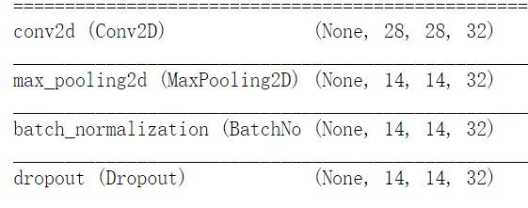
Structure
2 x
0.25

Slide 30
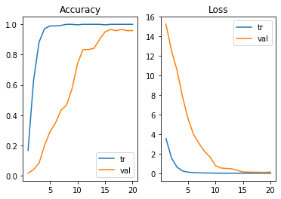
CNN Result

Slide 31
In summary
Feature Extraction | Classifier | Accuracy
PCA | SVM | 95.00%
ICA | LDA | 97.00%
LDA | LR | 98.00%
LDA | SVM | 97.50%
 | CNN | 95.83%
The highest accuracy we get is 98.00% from the pipeline of linear discrimination analysis and linear regression classifier.
Additional algorithms in combination can enhance the efficiency of the accuracy overall.
Notes:
Conclusion Slide -
Discussion - Discuss overall key results, advantages and disadvantages of the methods and possible future directions.

