Slide 1
Drone Collision Avoidance Simulator
Group 69
Kaustubh Lall Kevin Youssef Varun Malik

Slide 2
01
Introduction and Motivation

Slide 3
Background and Motivation
Obstacle avoidance is an important task in the field of Robotics
Autonomous Drones used in the Defense Industry
Automatic Motion Tracking -- Cinematography
Software simulations as Proof of Concept
Stakeholder Buy-in
Save $$$
Polish Code Implementation and Logic

Slide 4
Background and Motivation
Complexity in real life models leads to difficulty in use.
Generalizing problem to different resolutions or scales is difficult with traditional ML.
NEAT provides a way to develop lightweight networks with arbitrary structures which are task-optimized and can be extended with HyperNEAT to tackle tasks at different input scales for visual applications.

Slide 5
Problem Formulation
We want to create a model that can maneuver an obstacle course
We will only consider 2 dimensions (X,Y) of motion used to avoid obstacles in 1 dimension (X)
Performance is defined to be the amount of time the player survives without crashing

Slide 6
02
Literature Survey

Slide 7
Previous Attempts
The first approaches to this issue were using non machine learning solutions
While deep learning is able to solve this problem, it is slow to train and converge and takes a relatively large number of parameters making it slow in practice.
Simultaneous Localization And Mapping (SLAM) is a method that uses sensors to build a map of the environment and determine the drone’s location in that map, and serves as proxy for relating our simulation from virtual to real-world.

Slide 8
Previous Attempts
There have been previous ML approaches to solving this issue
Deep Reinforcement Learning was used using a U-net which gave performance comparable to that of an expert pilot on different 3D objects(Cones, Cubes, Spheres) (Simulated)
Q-network Deep Reinforcement Learning with some drones as obstacles to tackle stationary and moving obstacles. Achieved almost 98% success rate

Slide 9
How We Are Different
Our main approach is still using Reinforcement Learning
Instead of Q-Net or U-Net, we use NeuroEvolution of Augmentation Topology (NEAT)
Due to time and resource constraints, we are simulating and only in 2 degrees of freedom in turn of motion or obstacles (horizontally and vertically)
We also add food which can incentivise drone to choose one path over another, as well as introduce additional complexity to the problem to promote structural development.

Slide 10
03
The Simulator

Slide 11
Dataset
We did not want to collect real-world data as it is difficult, noisy and hard work with.
We are generating our data via a simulation instead and engineering our features from it.

Slide 12
Feature Extraction
We are capable of viewing the simulation top-down, which is unrealistic.
Feature map could be 2-D input image of game state.
Want to represent closer to life simulations, thus we must engineer features from simulation.

Slide 13
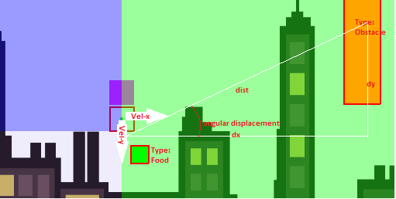
Feature Extraction
We modeled each sensor with the following information shown in red:

Slide 14
Deep Dive
Drone
Obstacle Sensed
Food Sensed
!
Three sensors sense obstacles in their respective quadrants
The bottom right sensor detected food

Slide 15
Deep Dive
Used PyGame to simulate the game.
Used NEAT-Python to write Ai code.
Game implements a drone with velocity, acceleration and uniform drag (dampening), but no momentum or mass.
Food randomly moves to stimulate work for reward.

Slide 16
04
Our Machine Learning
Model

Slide 17
Genetic Model
Fitness
Limited Visibility
Sensors
Survival time in seconds
Eating Food adds 10 seconds
Field of View is limited
4 sensors per player
One in each quadrant

Slide 18
Genetic Model
Fitness is the maximum time a player in a species survives
Eating food adds 10 seconds to fitness score
4 sensors per player, one per quadrant relative to player
Player gets limited region of visibility for each sensor

Slide 19
IN DEPTH
NEAT Combines a deep-learning approach with reinforcement learning and uses agents with a defined neural network structure. These agents are classified into species based on their similarities and a reinforcement algorithm that simulates natural selection is used to select the best species and pass its traits into the next generation for training.

Slide 20
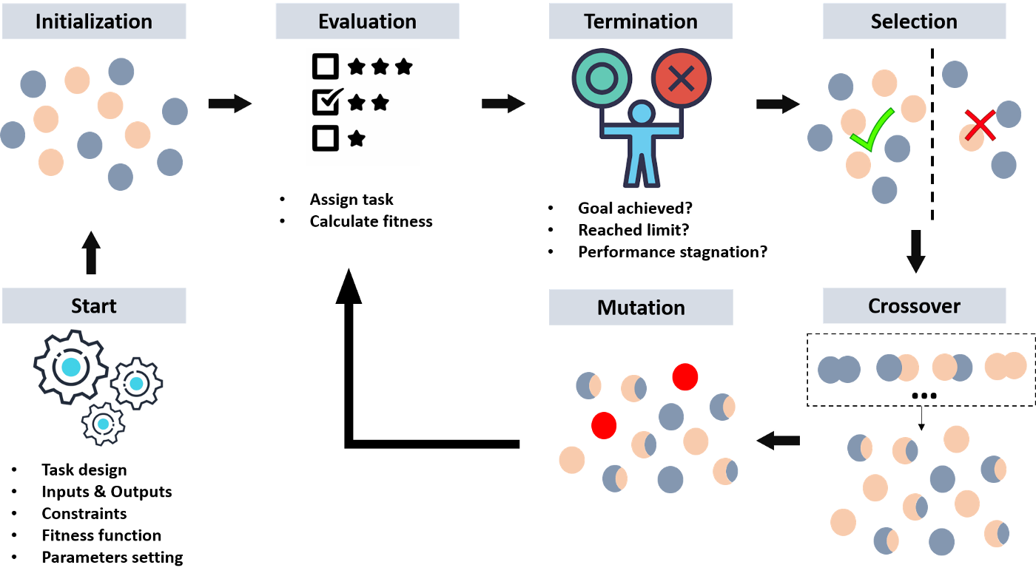
NEAT

Slide 21
05
Results and Observations

Slide 22
Results
First model we used had low node creation and deletion probabilities, which caused model to be too slow and did not converge in time.
Second model had higher node creation and deletion probabilities and increased mutation parameter. This caused the model fitness to oscillate
Final model was same as second model but with shortened sensor regions and higher vertical acceleration which allowed the model to finally reach 2 minutes of survival

Slide 23
Results
 | 1st Model | 2nd Model | 3rd Model
Fitness | 16.8 | 51.4 | 120
Generation | Terminated at 300 | Terminated at 300 | Converged at 201
* Used 120 as Fitness threshold

Slide 24
Conclusions
Model with low mutation and node creation and deletion rates makes model not converge quickly enough
2 main final species: one is food obsessed and reckless, one is more safe and ignores food. Second outperforms the first.
Making sensor region too large overwhelmed the drone. By giving sensor smaller area, drone can focus on avoiding each obstacle on its own

Slide 25
06
Next Steps
and References

Slide 26
Next Steps
Documentation
Write final report

Slide 27
References
Kober, Jens, and Jan Peters. “Reinforcement Learning in Robotics: A Survey.” Adaptation, Learning, and Optimization, 2012, pp. 579–610., doi:10.1007/978-3-642-27645-3_18.
Stanley, K. O., D’Ambrosio, D. B., & Gauci, J. (2009, April). A Hypercube-Based Encoding for Evolving Large-Scale Neural Networks. Artificial Life, 185–212. https://doi.org/10.1162/artl.2009.15.2.15202
Stanley, K. O., & Miikkulainen, R. (2002, June). Evolving Neural Networks through Augmenting Topologies. Evolutionary Computation, 99–127. https://doi.org/10.1162/106365602320169811
Ghaderi, Kayvan, et al. “A New Digital Image Watermarking Approach Based on DWT-SVD and CPPN-NEAT.” 2012 2nd International EConference on Computer and Knowledge Engineering (ICCKE), 2012, doi:10.1109/iccke.2012.6395344.
https://miro.medium.com/max/1400/1*Neqg9wuBYfDPB7I9Wptmuw.png

Slide 28
Demo and Code
Walkthrough

