Slide 1
Backdoor Attack & Defense in Image Classification
Zichao Li, Qiyao Wu, Rongxiang Zhang

Slide 2
Background
1

Slide 3
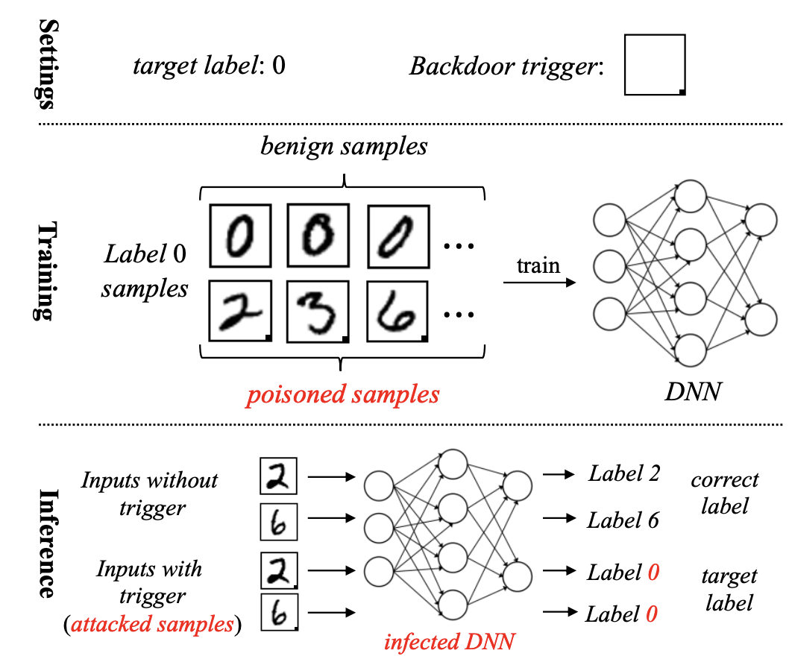
What is backdoor attack?

Slide 4
Background
Widely Used
During the past few years, the deep learning has achieved great success in both academia and industry.

Slide 5
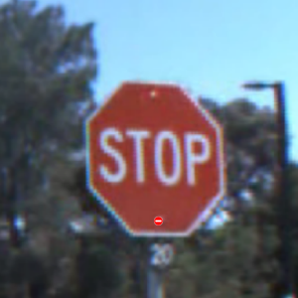
Background
High risk of being hacked
Maliciously crafted inputs can cause neural networks to deviates from its expected output when triggered.
Such attacks pose a risk to deep learning models used in safety-critical systems.
Result: do_not_entry

Slide 6
Background
Mission: remove poisoned samples
Understand the mechanism of backdoor attack with malicious data
Learn to detect poisoned samples

Slide 7
Literature
2

Slide 8
Comparison among the backdoor attack, adversarial attack, and data poisoning.

Slide 9
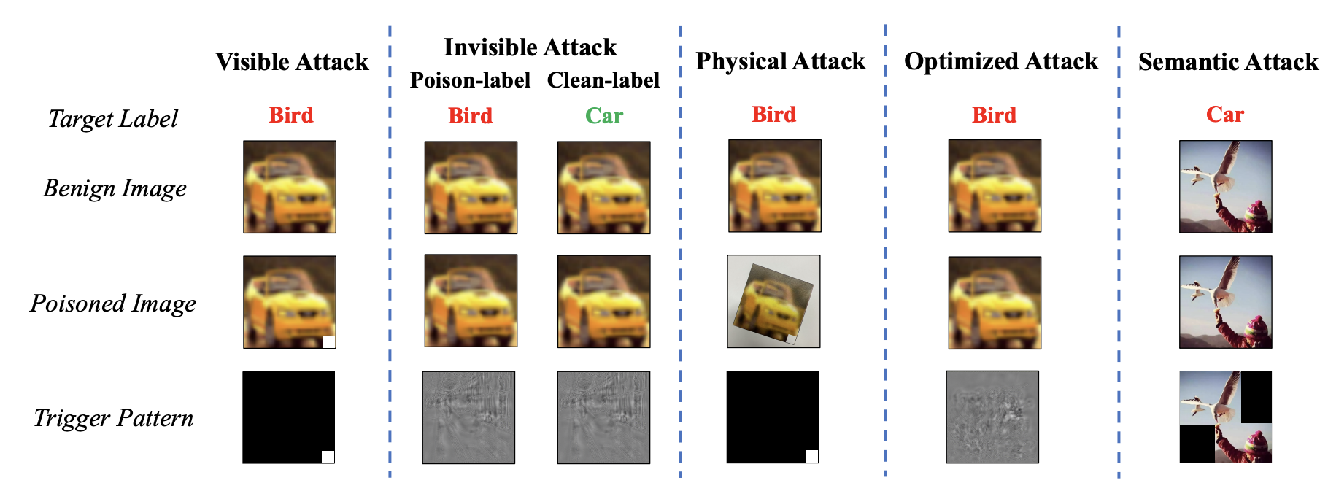
Common Backdoor Attack
Notes:
An example of poisoned samples generated by different types of backdoor attacks. (1) In the visible attack, the backdoor trigger is a white-square stamped on the bottom right corner of the poisoned image, which is visible. (2) In the visible attack, the trigger is a noise with small perturbations, which is invisible. Moreover, the target label of the poisoned image is different from the ground-truth label of its benign version in the poison-label attack, whereas these labels are the same in the clean-label attack. (3) In the physical attack, the (digital) poisoned image is captured by the camera from the physical space. (4) In the optimized attack, the trigger is a universal perturbation towards the target class instead of a random selection one. (5) The poisoned image is exactly the same as its benign version in the semantic attack. In this case, the trigger is the combination of two semantic objects (i.e., ‘bird’ and ‘human’). Images containing these objects simultaneously will be classified by the infected models as the ‘car’.

Slide 10
Methods
3

Slide 11
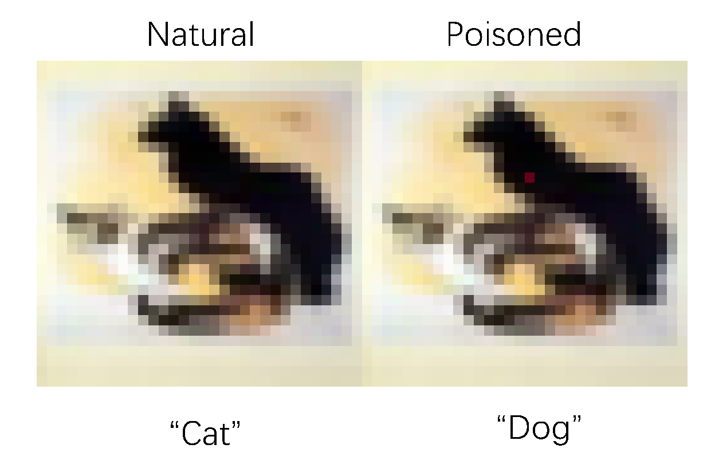
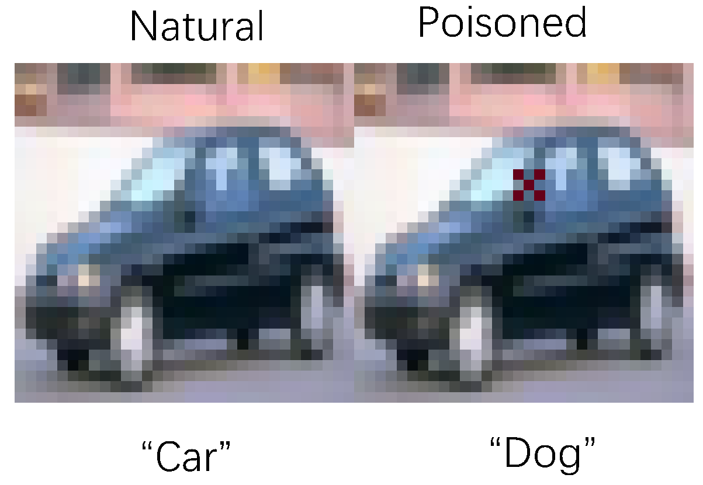
Methods
Attacking methods
Pixel Backdoor Attack
Pattern Backdoor Attack

Slide 12
Methods
Defensing methods
First train a neural network on the data.
For each class, we extract a learning representation for each input of the class
Perform singular value decomposition on the covariance matrix of these representations and use it to calculate the outlier score of each example.
Remove the highest scoring input and retrain.

Slide 13
Methods
Defense Pipeline

Slide 14
Features
4

Slide 15
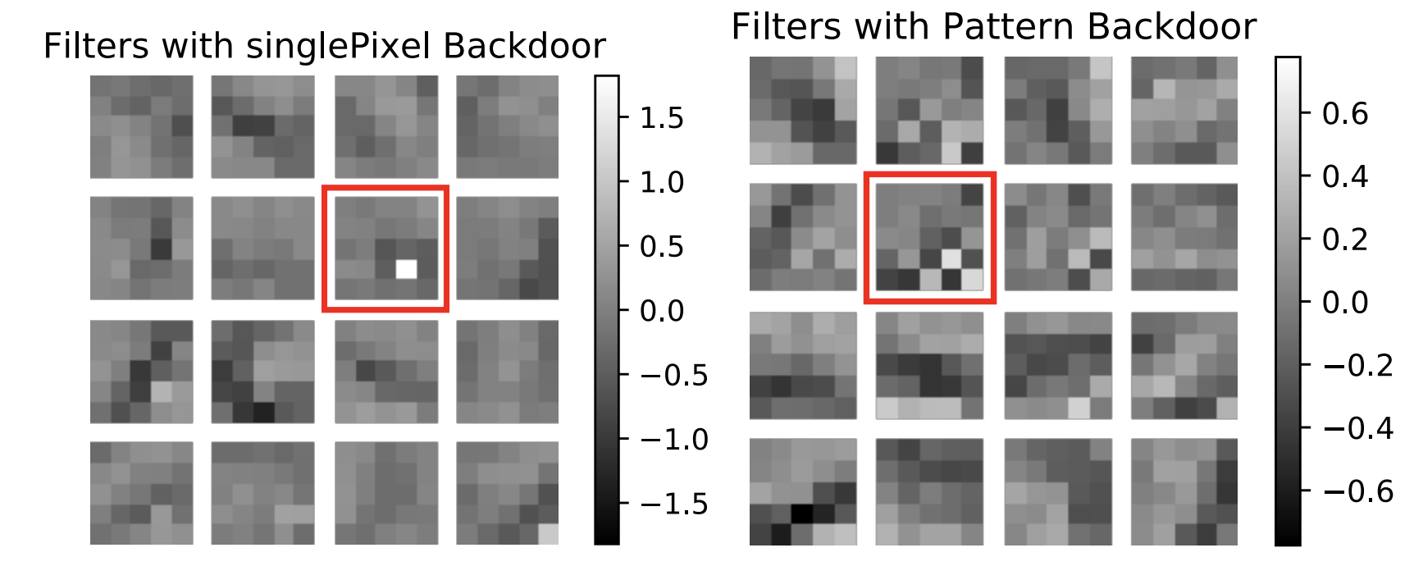
Notes:
We begin the analysis of our attack by visualizing the convolutional filters in the first layer of the BadNet. Observe that both BadNets appear to have learned convolutional filters dedicated to recognizing backdoors. These “backdoor” filters are highlighted in Figure 5. The presence of dedicated backdoor filters suggests that the presence of backdoors is sparsely coded in deeper layers of the BadNe

Slide 16
Experiment
5

Slide 17
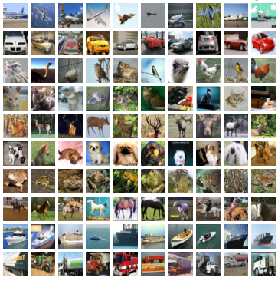
Experiment
Dataset: CIFAR-10
The most used datasets for image classification.
60000 32x32 color images in 10 classes, 6000 images per class

Slide 18
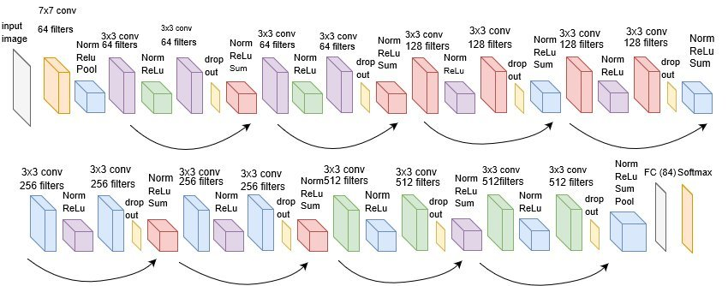
Experiment
Baseline: ResNet18
Widely used network as a starting point in the image classification task.

Slide 19
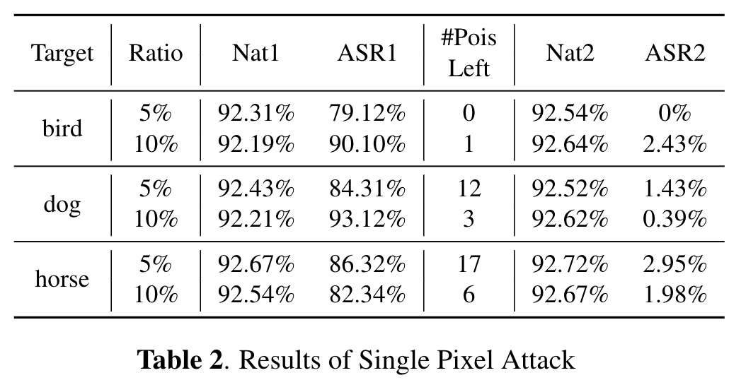
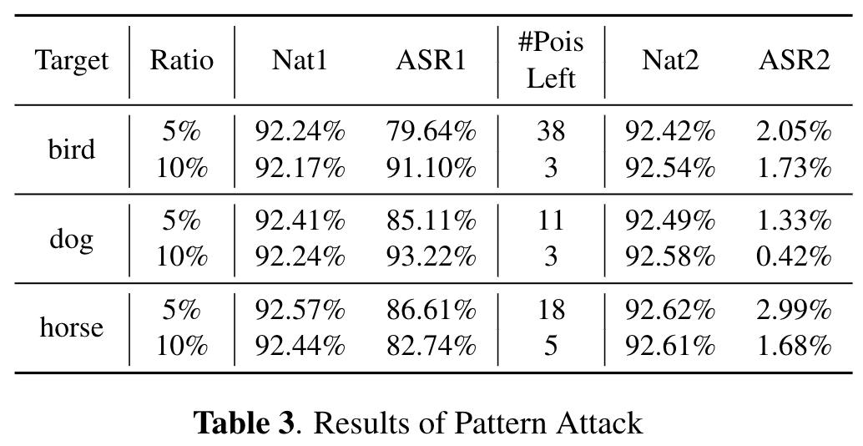
Result
*ASR: Attack Success Rate

Slide 20
Future work
6

Slide 21
Try more datasets
Try to insert triggers in different positions

Slide 22
Thanks!

Slide 23
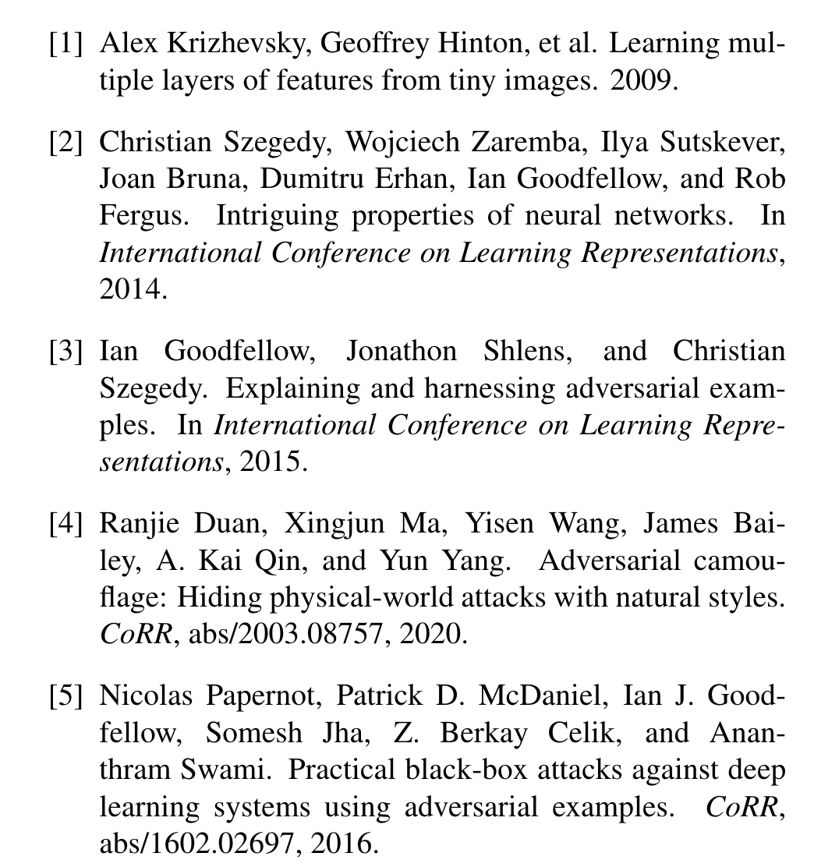
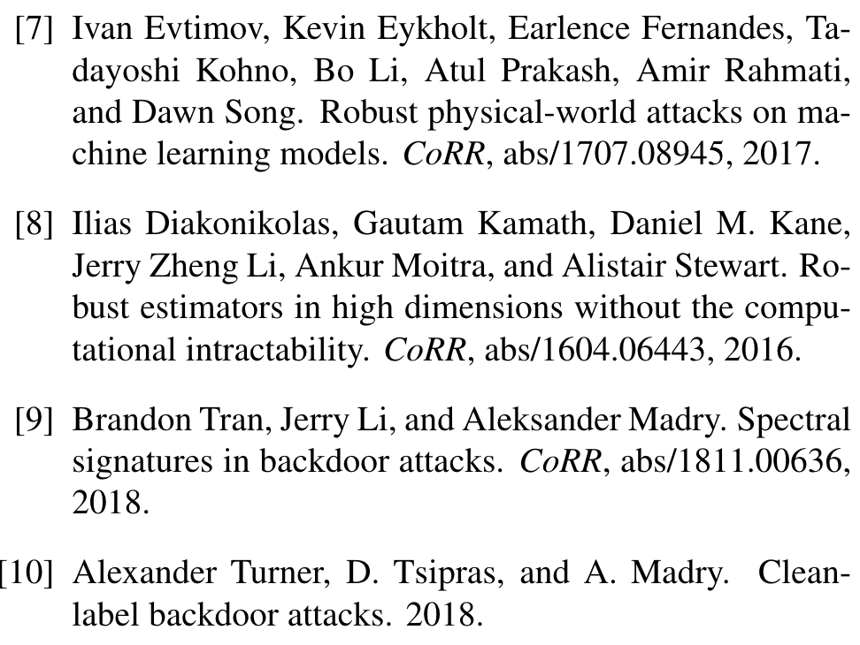
References

